Slide 1





A multidisciplinary approach to the use of technology in research: the case of interview data
Louise Corti
Christoph Draxler
Parthenos workshop for CEE Countries
7-9 October 2019,
Sofia

Slide 2
Welcome
Thank you for joining us here in Sofia!
Part of Parthenos workshop for CEE Countries
Thank to the great organising team!

Slide 3
Who are we?
A multidisciplinary group of European scholars
tools and data professionals
fields - speech technology, social sciences, human computer interaction, oral history and linguistics
Interested in strengthening the position of interview data in Digital Humanities
Arjan van Hessen Christoph Draxler
Stef Scagliola Louise Corti
Silvia Calamai Jeannine Beeken
Henk van den Heuvel Norah Karrouche

Slide 4
Thanks to our Oral Hisory.eu colleagues
Stefania Scagliola, University of Luxembourg
Silvia Calamai, University of Siena
Norah Karrouche, Erasmus University Rotterdam
Jeannine Beeken, University of Essex
Arjan van Hessen, University of Twente
Henk van den Heuvel, Radboud University
Maureen Haaker, University of Essex
Max Broekhuizen, Erasmus University Rotterdam

Slide 5
Aims of our multidiscplinary work
Explore the applicability and usefulness of existing infrastructure & tools for non-digital humanities approaches
Elucidate why ‘language & linguistic’ tools are not typically used by social science or humanities scholars
Identify the barriers to using such methods and tools
  paradigms, methods, jargon, technical ability, tool familiarity
Explore how these can be utilised by scholars using interview data

Slide 6
An open mind...expanding one’s toolbox
Consider preparing - reading - listening - viewing
Features of audiovisual and textual data that users may not have previously considered
We believe that open-source tools can offer benefits to preparing ‘data’ and to interpreting them
Workshop feedback very useful to gather uEx

Slide 7
Background and user gatherings
Stream of activity around the exploitation of techniques and tools for working with oral history (OH) data
  Oralhistory.eu site: Oxford, Arezzo, Munich and Utrecht
Explore the diversity of scholarly practices across disciplines who use interview data sources in their daily
work: digital humanities, linguistics, oral history and traditional social science
Previous 4 workshops - tools specialists, data stewards and scholars

Slide 8
Types of tools our workshops have explored
Transcribing and aligning oral sources:
  TChain
Annotating text - using pre processing or not:
  ELAN, NVivo and TXM
Applying linguistic tools to oral history data
  Voyant, SketchEngine, StanfordCoreNLP,
Using emotion recognition tools
  OpenSmile, Praat

Slide 9
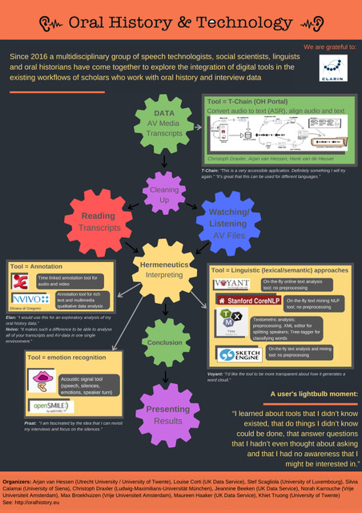

Slide 10
Structure of our workshop
Part 1: Lecture
Introducing different scholarly approaches when working with interview data as a primary or secondary data source: distinct traditions and differences in analytic practices and use of tools by scholars across the disciplines
Automated speech recognition, annotation, text analysis and emotion recognition tools are open to wider exploitation
Presentation of TChain tool
Your experiences

Slide 11
Structure of our workshop
Part II Demo and hands-on
The Transcription Chain (TChain) - a tool to convert audio-visual material into a suitable format, use automatic speech recognition (ASR), correct the ASR results, and download them
Discussion of potential of the T-Chain and whether a call for other languages to be integrated into the T-Chain
Emotion recognition video
Exercise & group discussion of your own scholarly work flows and tools when/if analysing interview text

Slide 12
Information - shared drive
The workshop materials
Tiny url: http://tiny.cc/sg93dz

