Slide 1

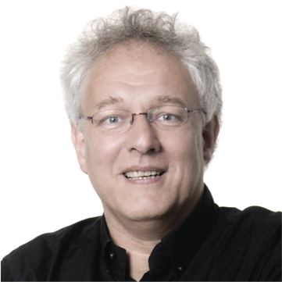
HLT & AI
Arjan van Hessen
Universiteit Twente
Universiteit Utrecht

Slide 2
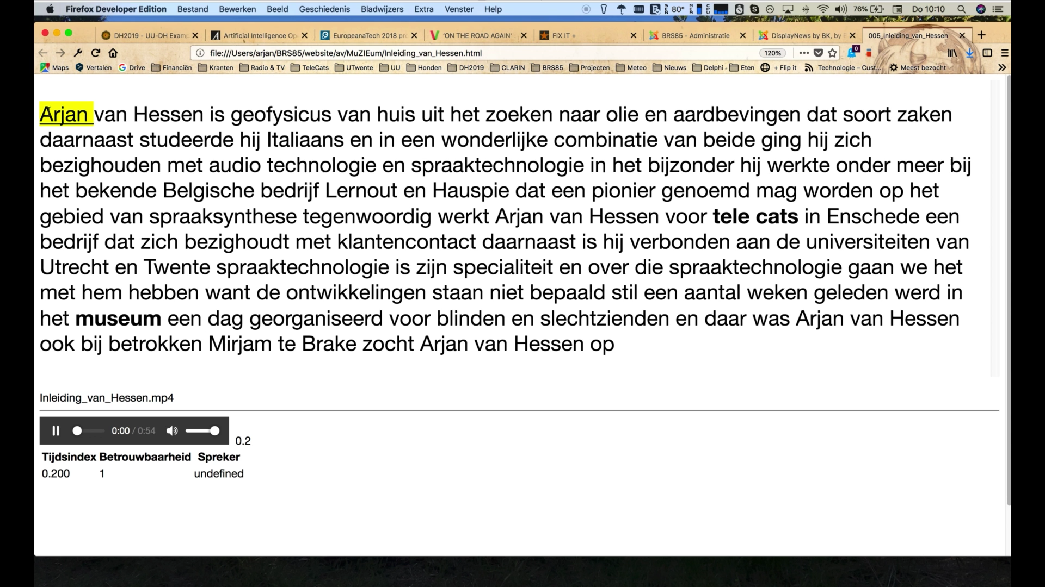

Slide 3
Development of asr
Global overview of how ASR works

Slide 4
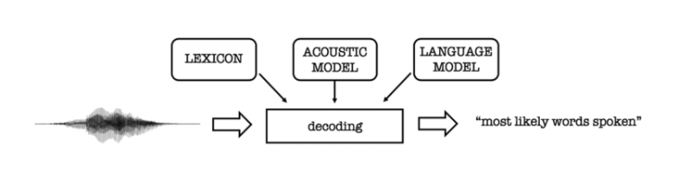
Development of ASR (last 15 years)
Lexicon Model
The lexicon model describes how words are pronounced phonetically. You usually need a custom phoneme set for each language, handcrafted by expert phoneticians.
Acoustic Model
The acoustic model (AM), models the acoustic patterns of speech. The job of the acoustic model is to predict which sound or phoneme is being spoken at each speech segment from the forced aligned data. The acoustic model is usually of an HMM or GMM variant.
Language Model
The language model (LM) models the statistics of language. It learns which sequences of words are most likely to be spoken, and its job is to predict which words will follow on from the current words and with what probability.

Slide 5
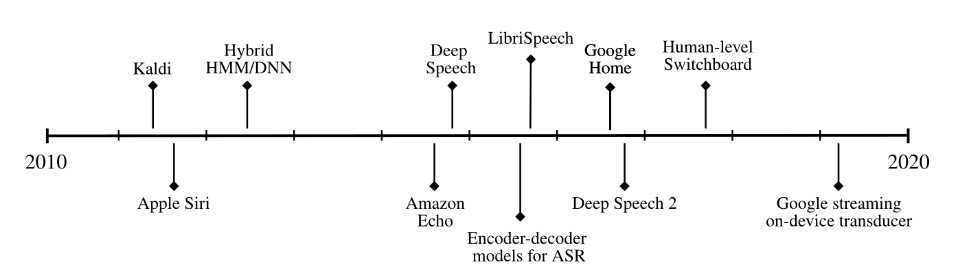
Development of ASR (last 15 years)

Slide 6
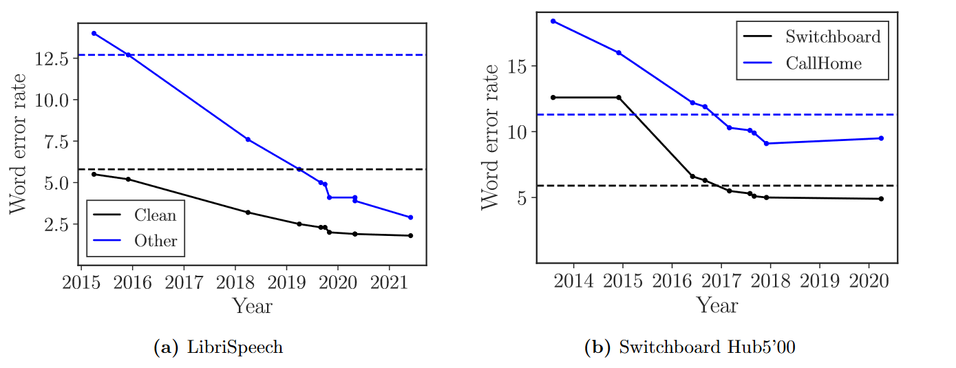
American-English

Slide 7
But… in September 2022 a new, very good working and open-source ASR-tool appeared.
Final ASR engine?
Works ± on the human level

Slide 8
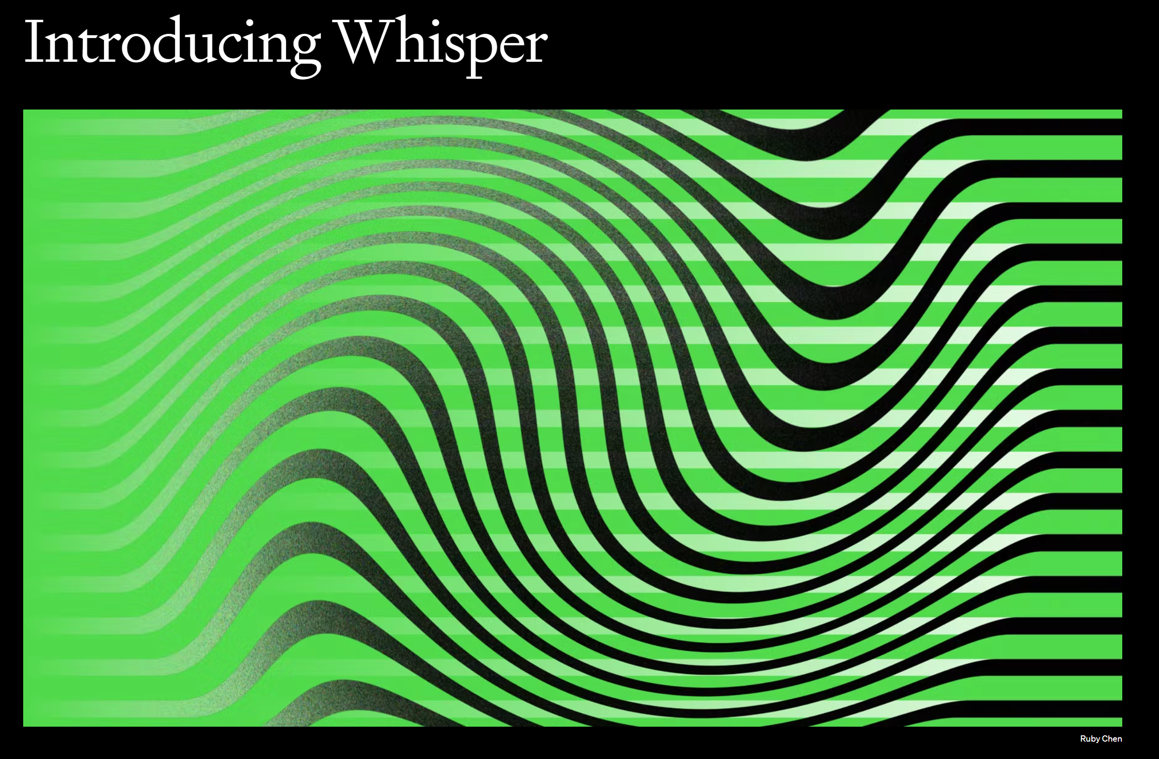
September 2022

Slide 9
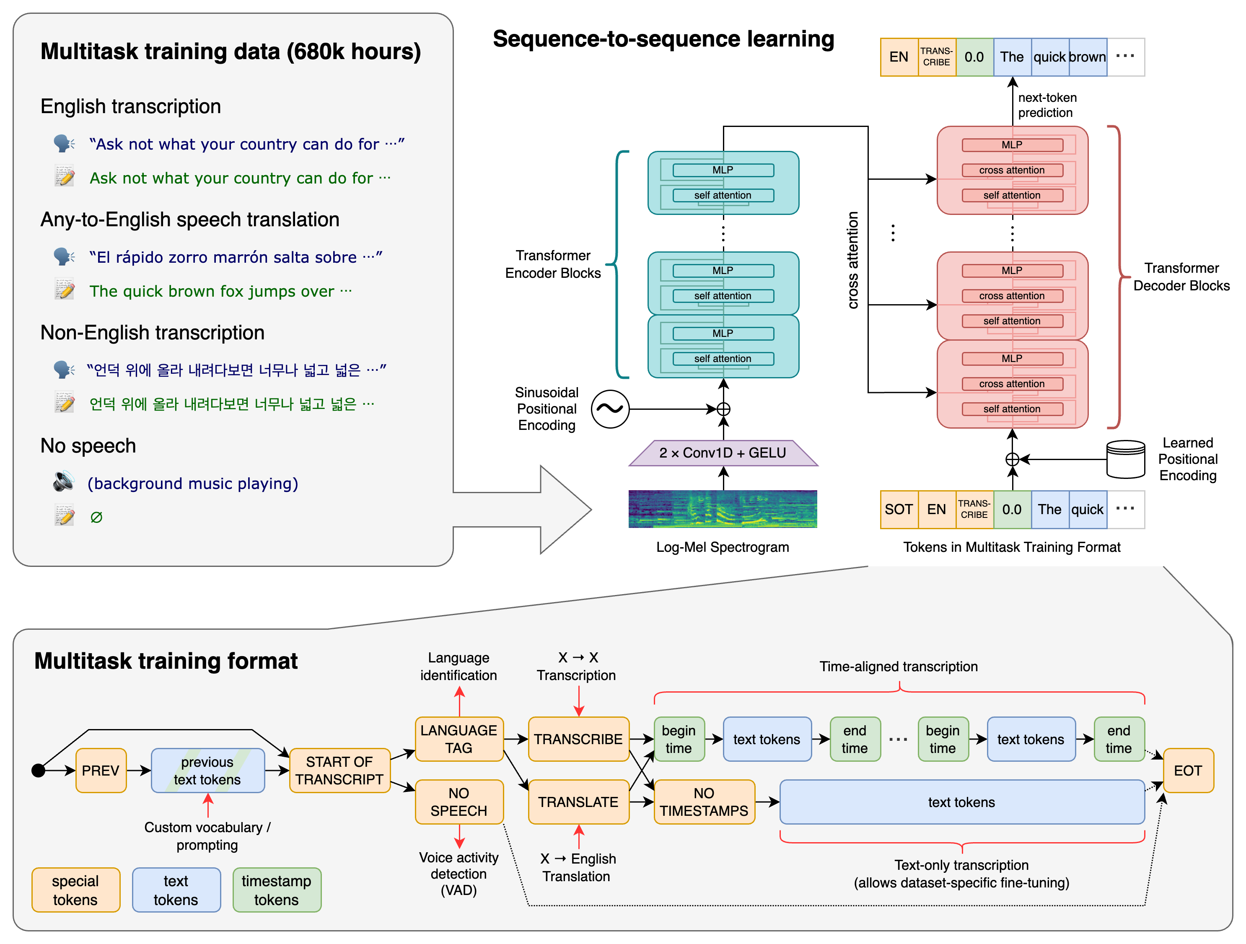
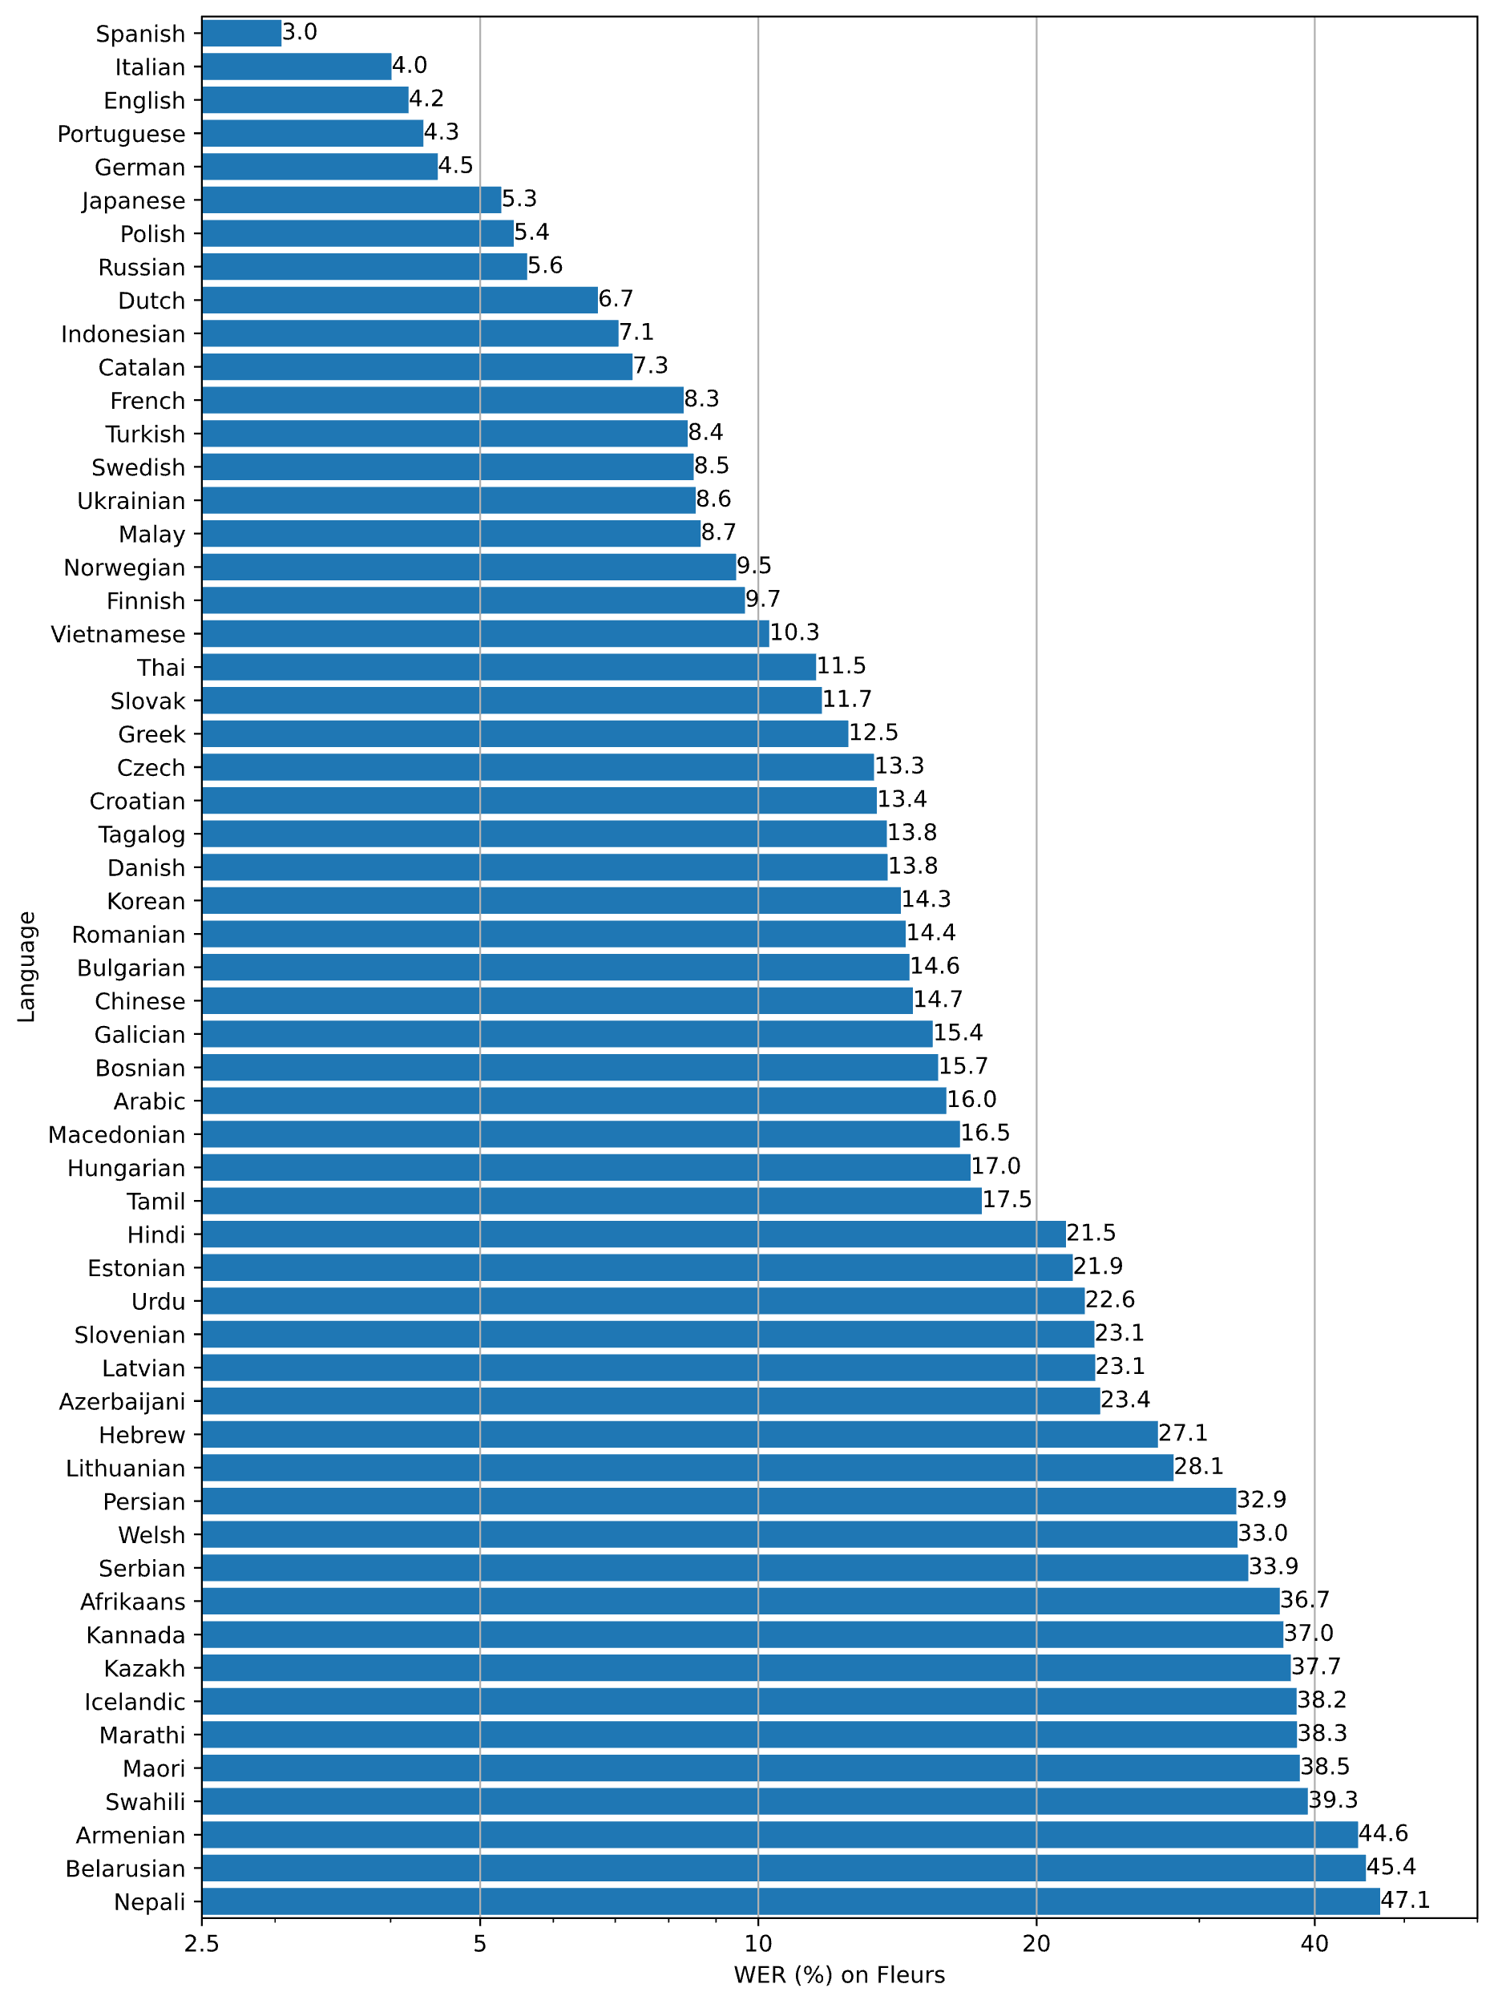

Slide 10
How does Whisper works?

Slide 11
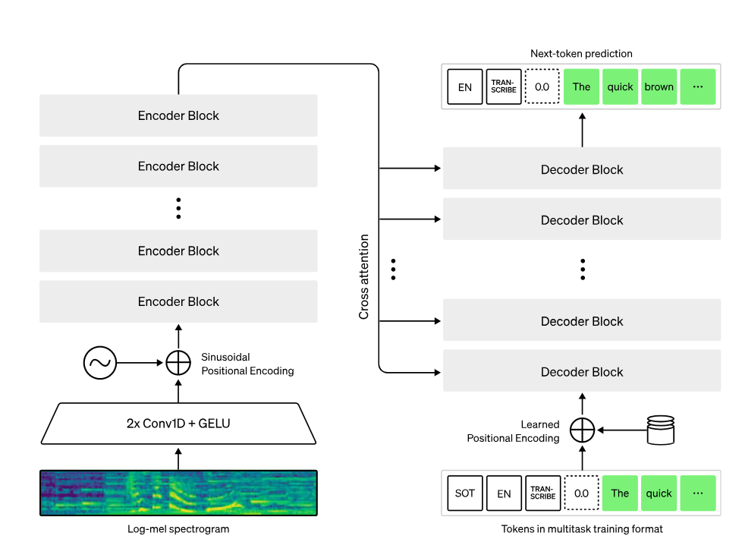
How does Whisper works?
Whisper is a state-of-the-art automatic speech recognition (ASR) system that has been trained on an extensive and varied dataset of 680,000 hours of multilingual and multitask supervised data obtained from the internet.
The research indicates that utilizing such a
vast and diverse collection leads to enhanced resilience against accents, ambient noise disturbances as well as technical jargon.
Additionally, it facilitates transcription in several languages while also allowing for translation into English from those tongues.
We are releasing our models along with inference code under open-source licensing terms so they can serve as building blocks towards creating practical applications or furthering investigations pertaining to robust speech processing techniques.
However, with Whisper OpenAI, you can convert speech to text efficiently and accurately and leave more time for productive work.
With the growing importance of voice-enabled devices, Whisper OpenAI is a must-have tool for anyone who wants to get ahead in the field of speech recognition.

Slide 12
Installing Whisper
Can be used:
On your own device
On a fast computer in your department
As a service in the cloud (for example SURF)
As a paid service by for example Open AI

Slide 13
Install Whisper(X)
  Install first
    Python (3.8 – 3.10)
    I have used 3.9.9 (AvH)
    PyTorch (1.10.1 or 2.0)
    ffmpeg
  Then
    Whisper:
    pip3 install git+https://github.com/openai/whisper.git
    Whisperx:
    pip3 install git+https://github.com/m-bain/whisperx.git

Slide 14

Install Whisper
Everything with one script
See this video
OR…
Type:
iex (irm whisper.tc.ht)

Slide 15
Using Whisper
Models
Standalone software

Slide 16
Using Whisper
Size | #Parameters | English-only model | Multilingual model | Required VRAM | Relative speed
tiny | 39 M | tiny.en | tiny | ~1 GB | ~32x
base | 74 M | base.en | base | ~1 GB | ~16x
small | 244 M | small.en | small | ~2 GB | ~6x
medium | 769 M | medium.en | medium | ~5 GB | ~2x
large-v2 | 1550 M | N/A | large | ~10 GB | 1x
Large-v3 | 1550 M | N/A | large | ~10 GB | 1x

Slide 17
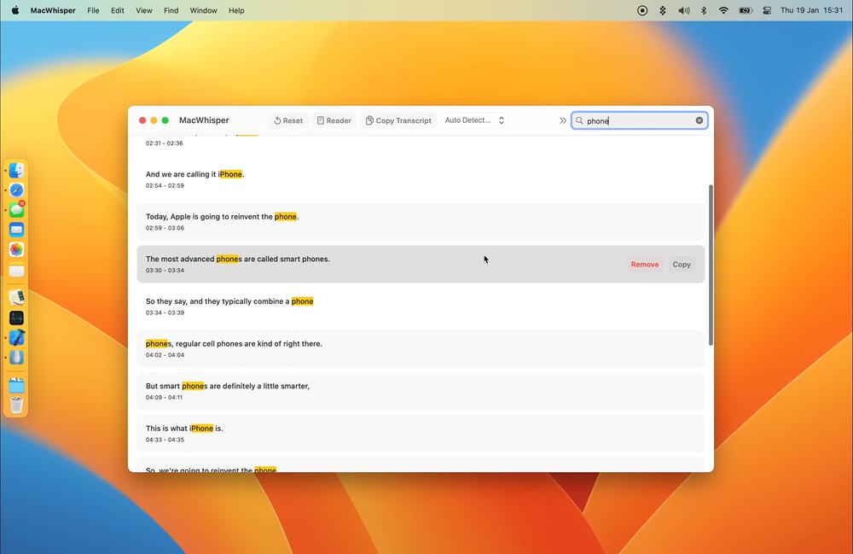
Whisper tools
WhisperX: Time-Accurate Speech Transcription of Long-Form Audio
MacWhisper (V10.4): a MacOS tool for ASR with whisper

Slide 18
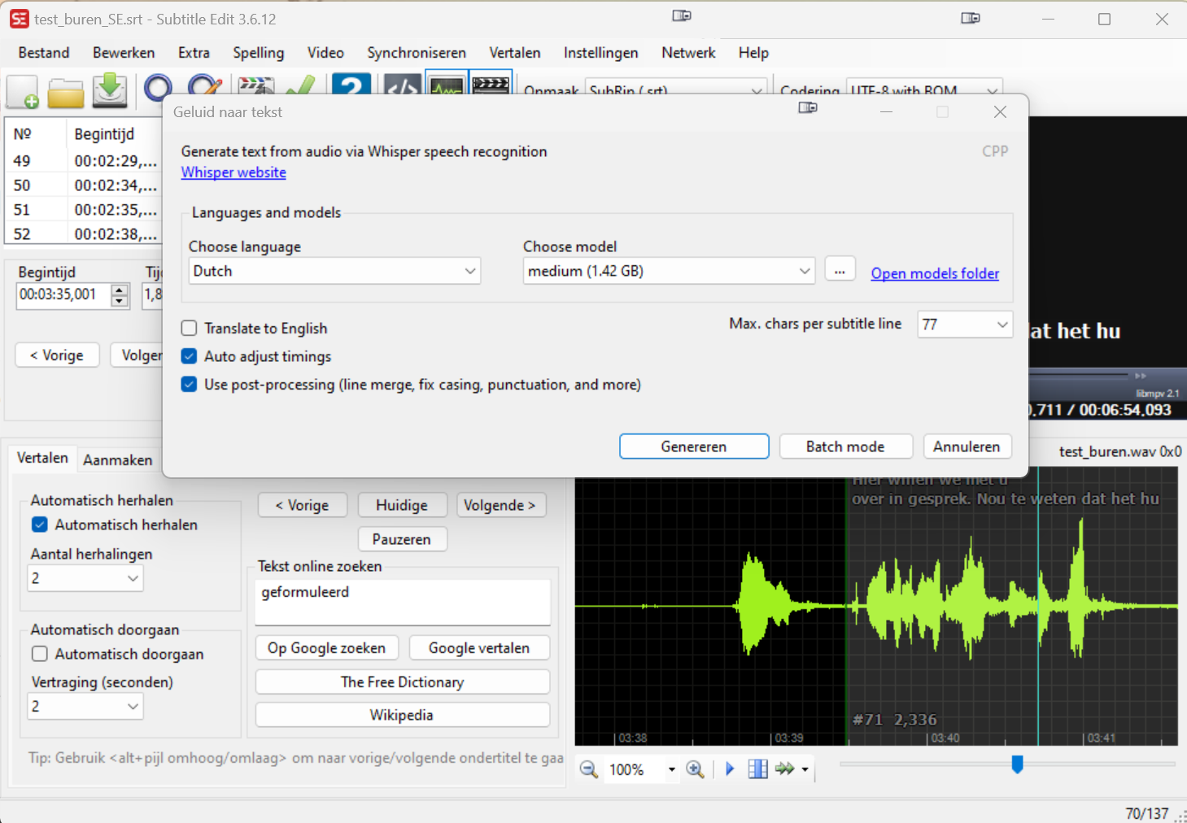
SubtitleEdit V3.6.11+

Slide 19
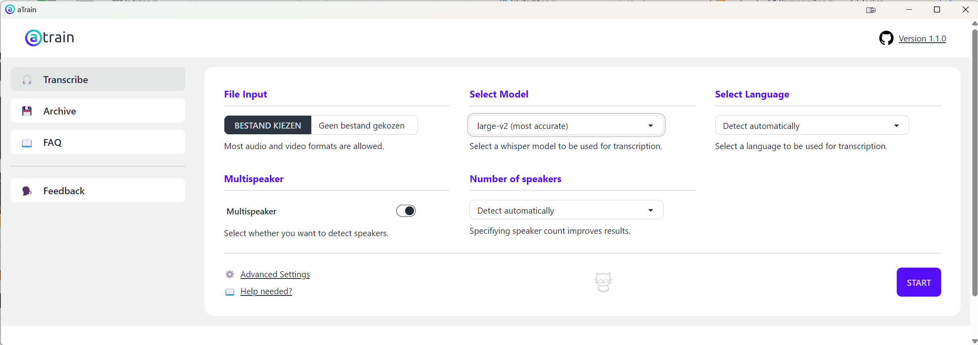
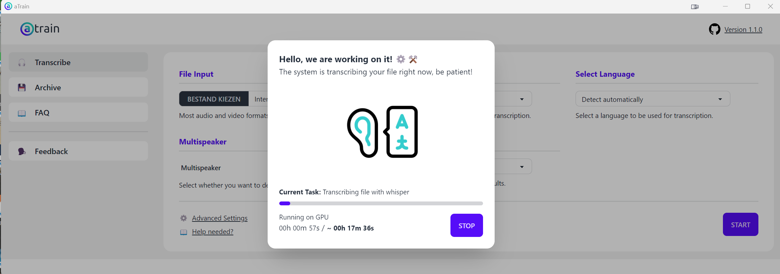
aTrain

Slide 20
aTrain
aTrain is a software package from the University of Graz. It can be downloaded via:
https://apps.microsoft.com/detail/atrain/9N15Q44SZNS2
It is large but (nearly) up-to-date.

Slide 21
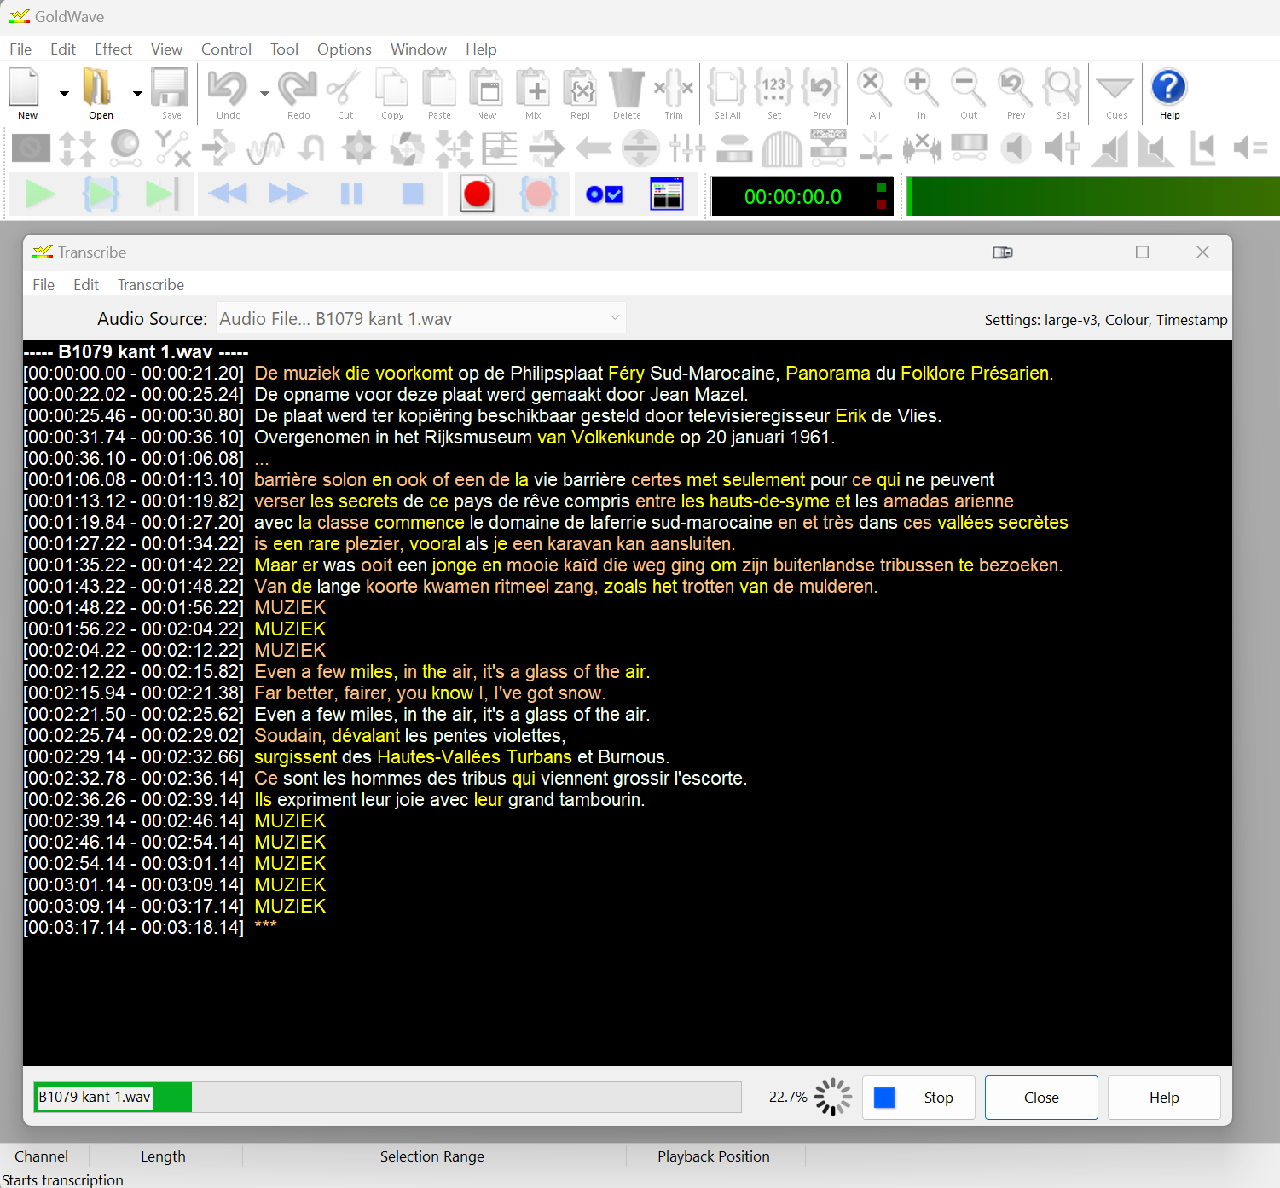
GoldWave v7.00+
GoldWave runs the transcriptions (very) slow but has some very nice features.
For example:
it detects language changes in the file and adjusts the output accordingly.

Slide 22
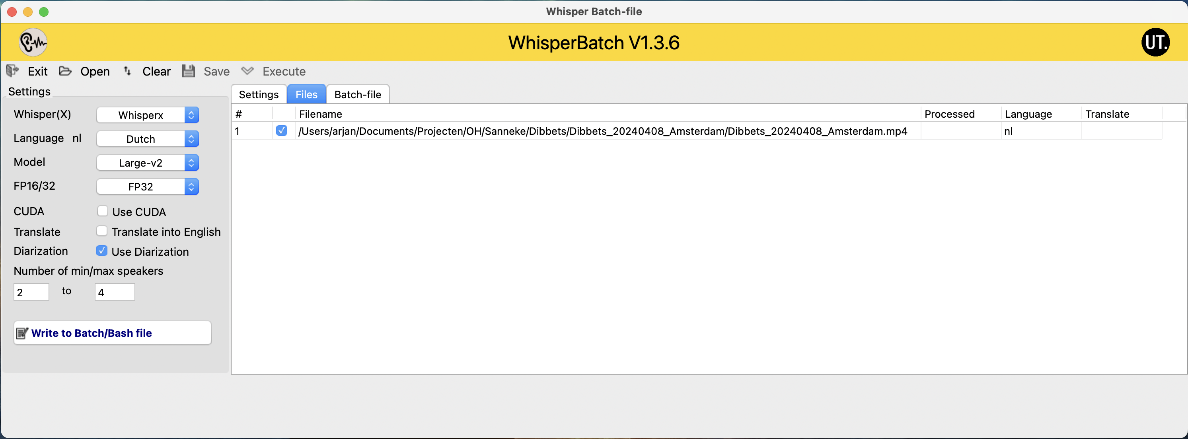
Multiple files in Batch
WhisperBatch

Slide 23
After the recognition(s)
Reading
Studying
Disclosing
More…

Slide 24
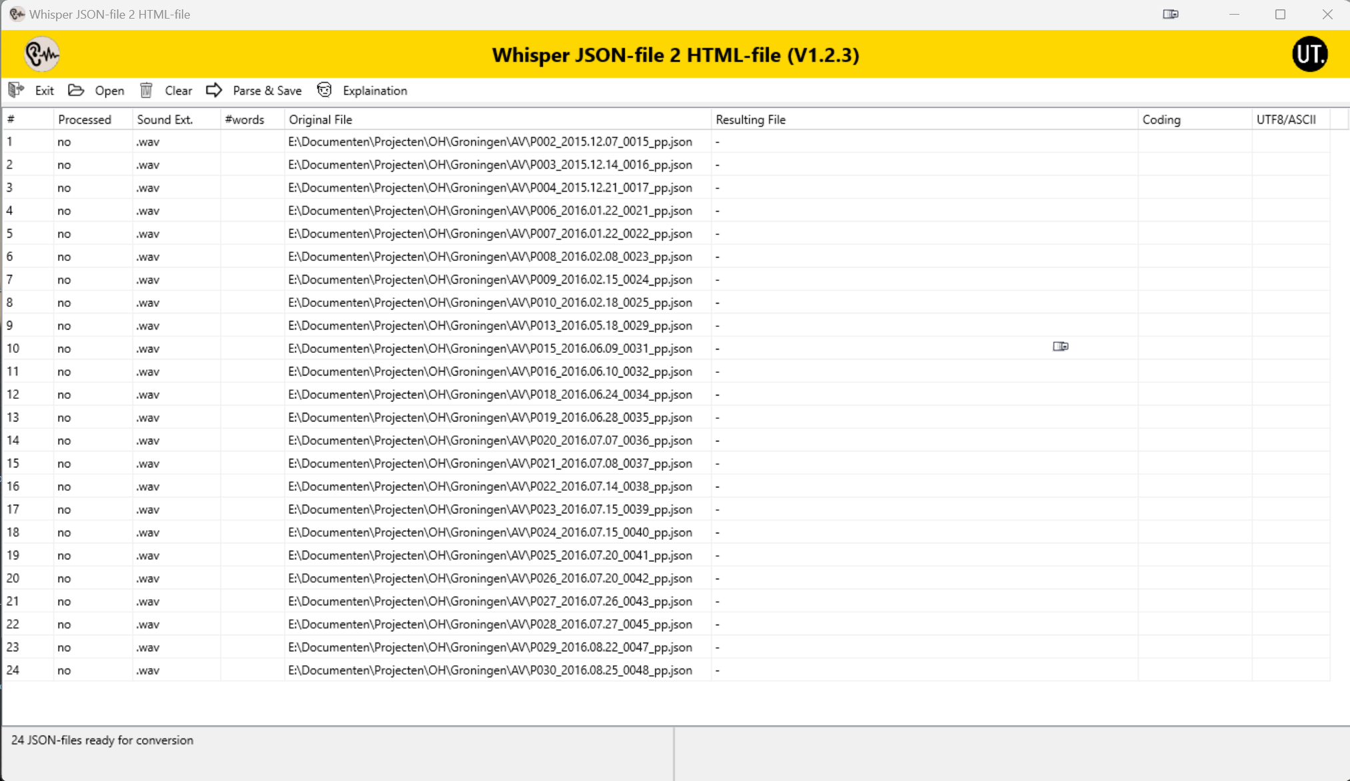
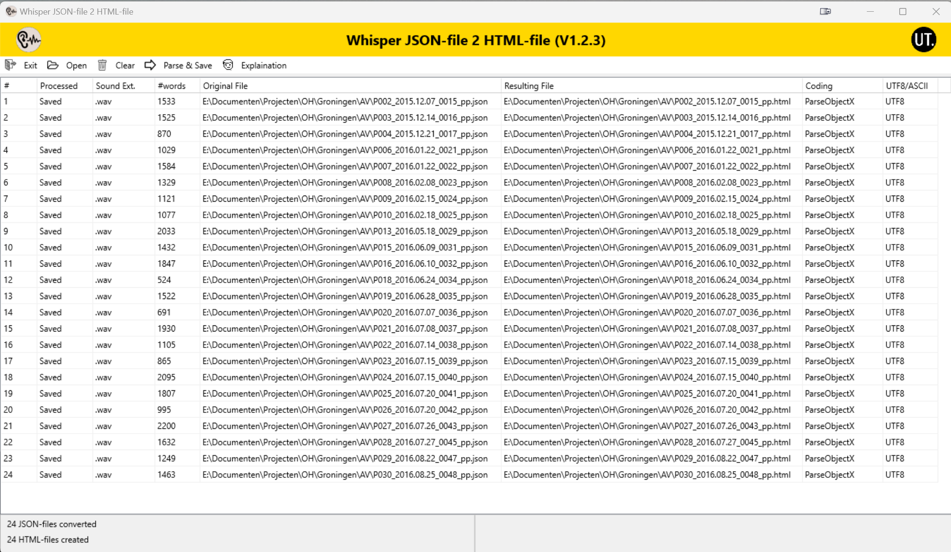
Reading and Listening

Slide 25
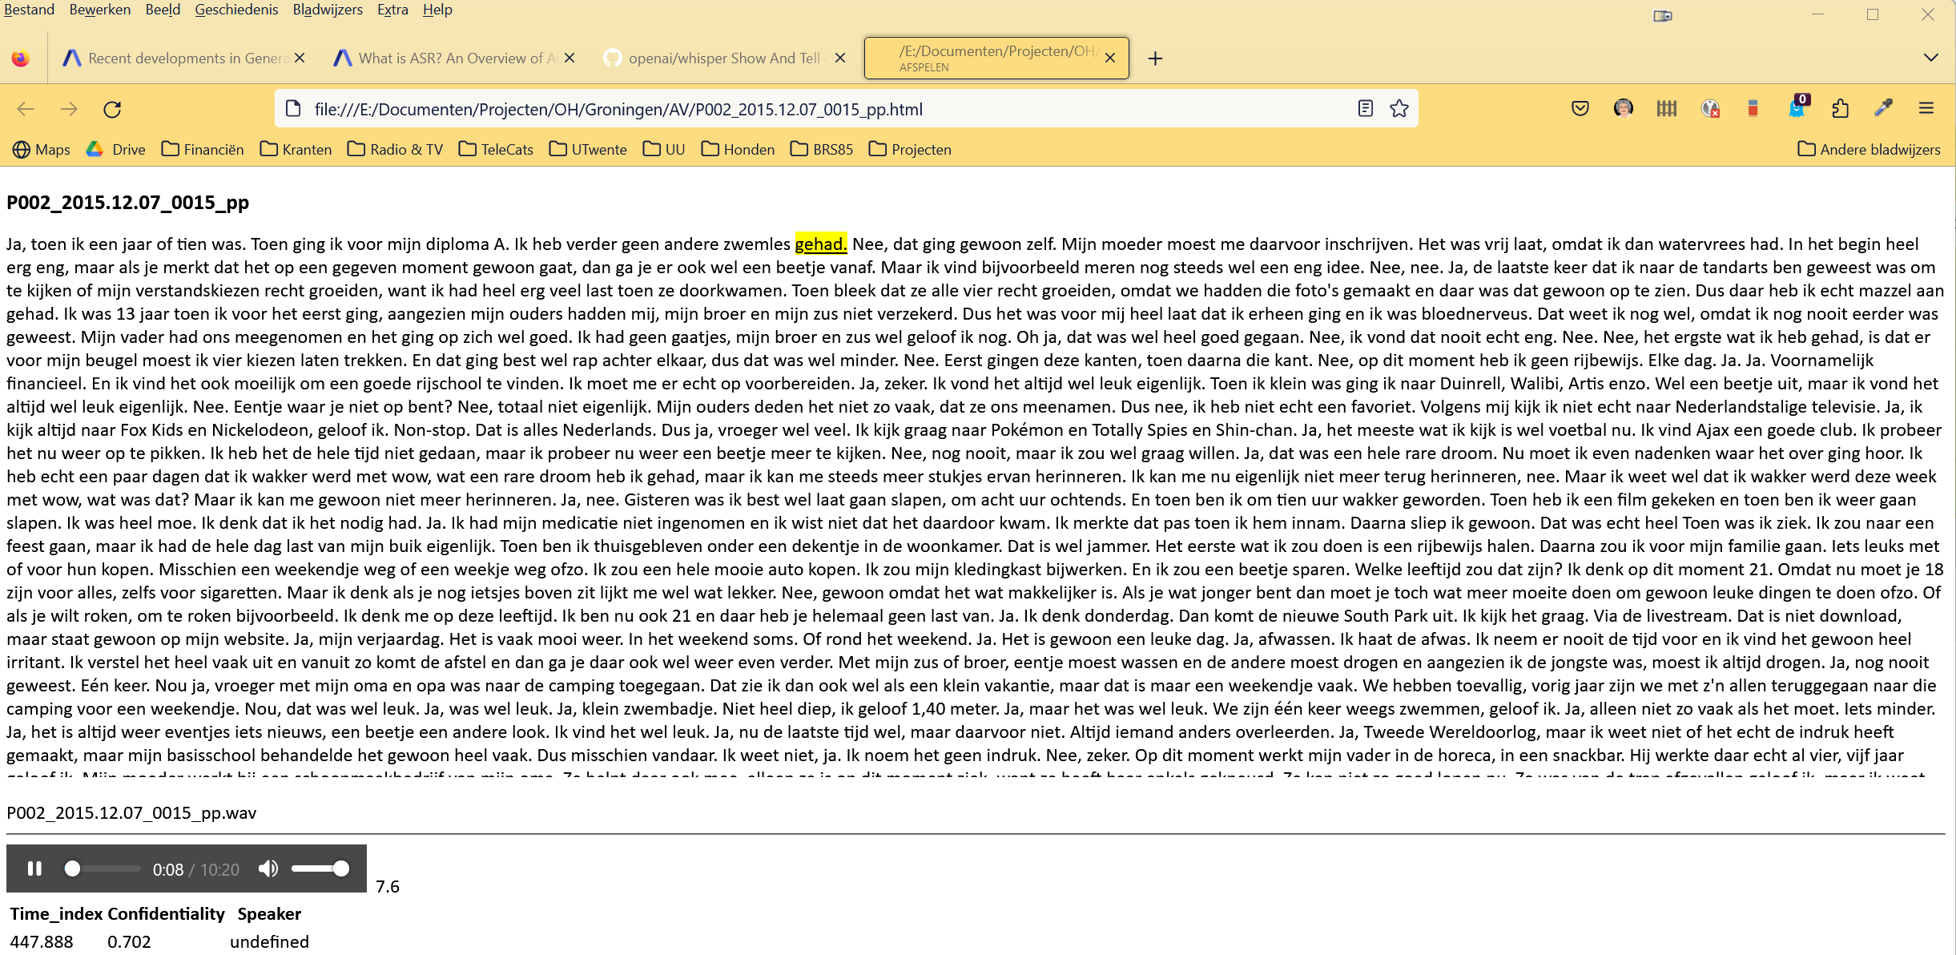
Reading and Listening

Slide 26
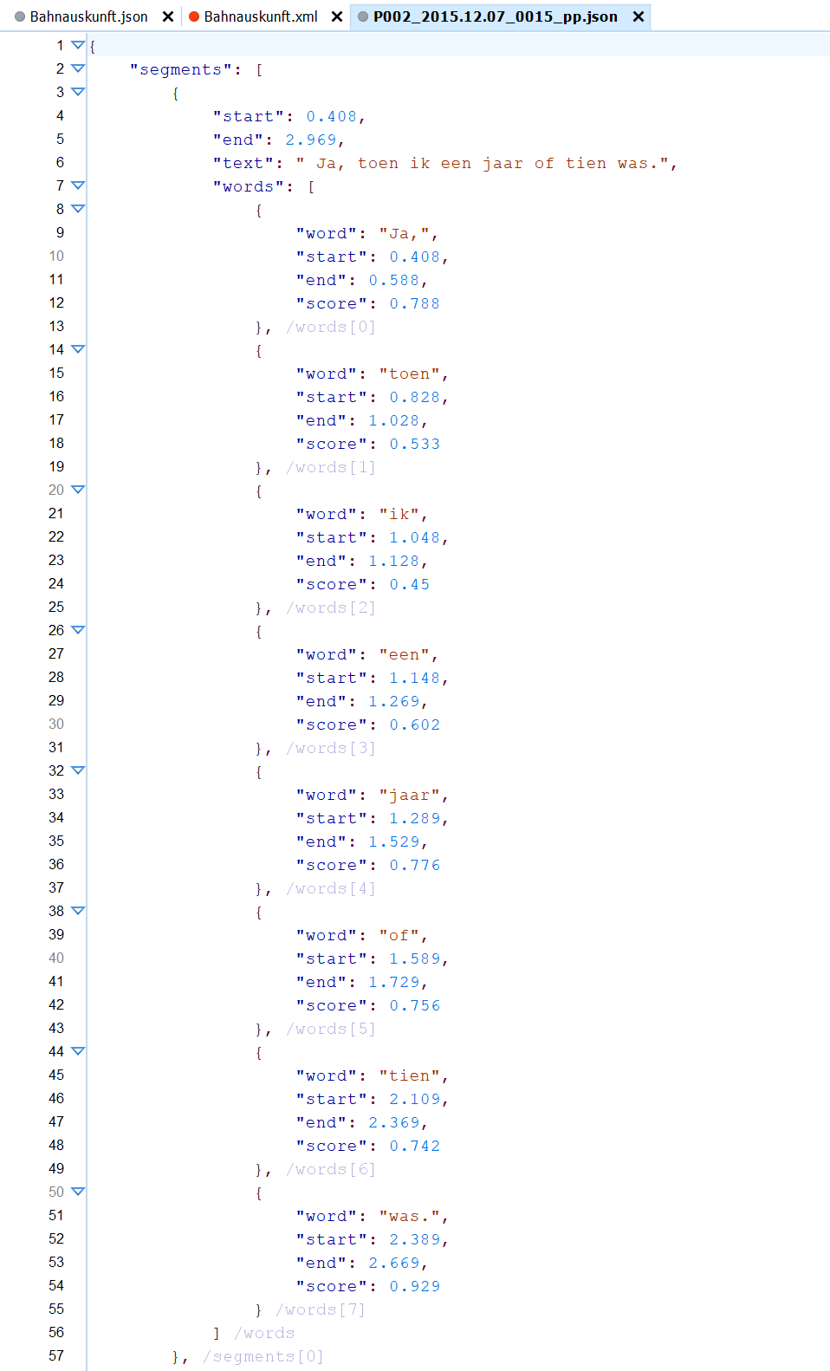
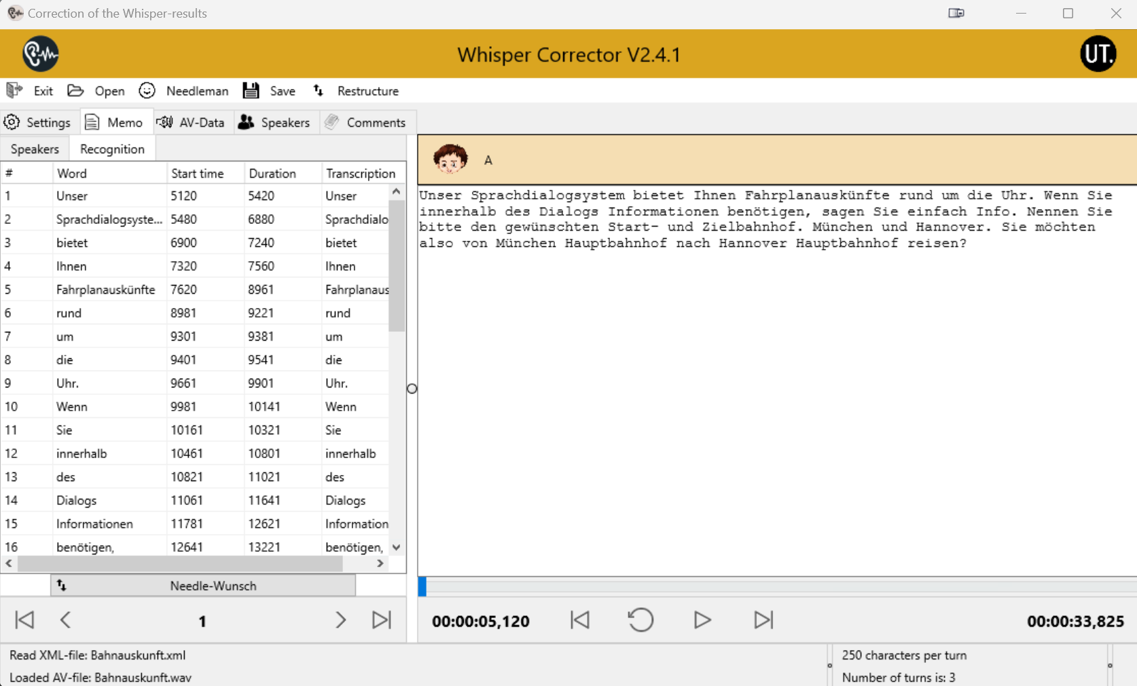
Studying & Correcting

Slide 27
Future?

Slide 28
Future ASR?
The result is generated using LLMs, making sometimes the transcription “too nice”.
The Start- and End-times are not very accurate (better with WhisperX)
It can be done (much) faster!

Slide 29
Future ASR!
Dialects and Accented speech and speech of children or very old people, is often less well recognised.
Golshid Shekoufandeh (PhD, UvA) tries to solve this problem.

Slide 30
Future ASR-related work!
Non-verbal speech.
Once we can do something, it will be used!
Decide how people say items and if they are convinced or not?
Visual recognition (most interviews will be AV)
Is the audio in sync with the image?
Are they convinced of what they are saying?

Slide 31
Google's Universal Speech Model
Performs Speech Recognition on Hundreds of Languages
USM...can perform automatic speech recognition (ASR) on widely-spoken languages like English and Mandarin, but also languages like Punjabi, Assamese, Santhali, Balinese, Shona, Malagasy, Luganda, Luo, Bambara, Soga, Maninka, Xhosa, Akan, Lingala, Chichewa, Nkore, and Nzema.
Some of these languages are spoken by fewer than twenty million people, making it very hard to find the necessary training data.
Google demonstrates that utilizing a large unlabeled multilingual dataset to pre-train the encoder of our model and fine-tuning on a smaller set of labeled data enables us to recognize these under-represented languages.
Moreover, the model training process is effective for adapting to new languages and data.

Slide 32
What questions do you have for me?

