Slide 1
Voices from Ravensbrück; Towards the creation of a multilingual oral history resource family
Silvia Calamai Università di Siena Siena, Italy silvia.calamai@unisi.it | Jeannine Beeken University of Essex Colchester, United Kingdom jeannine.beeken@essex.ac.uk
Max Broekhuizen Erasmus School of History Rotterdam, The Netherlands maksbroekhuizen@gmail.com | Christoph Draxler Ludwig Maximilian University Munich, Germany draxler@phonetik.uni-muenchen.de
Arjan van Hessen University of Twente Enschede, The Netherlands a.j.vanhessen@utwente.nl | Henk van den Heuvel Radboud University Nijmegen, The Netherlands h.vandenheuvel@let.ru.nl
Stefania Scagliola University of Luxembourg Belval, Luxembourg scagliolas@gmail.com

Slide 2
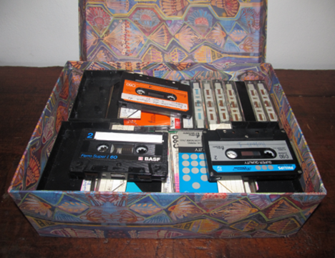
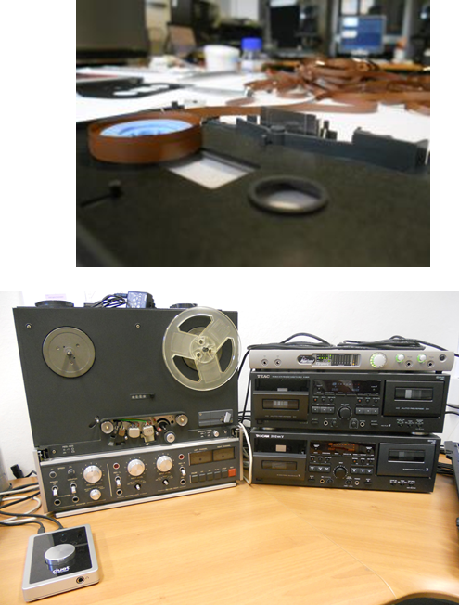

Slide 3
The potential of Oral History for CLARIN
The Interview as data type is at the crossroads of different scholarly fields
Under-utilized outside the Oral History community but a promising datatype
Process of co-creation (shared authority with the interviewee)
Multimodal (speech, audio, video, transcript, memory, language, meaning)
Digital access creates opportunities for cross-lingual collaboration
Thousands of existing analogue oral history archives are awaiting to be opened up and re-used by scholars of different disciplines

Slide 4
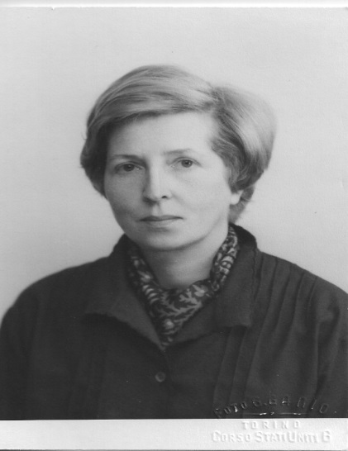
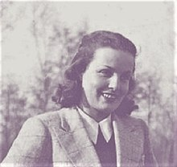
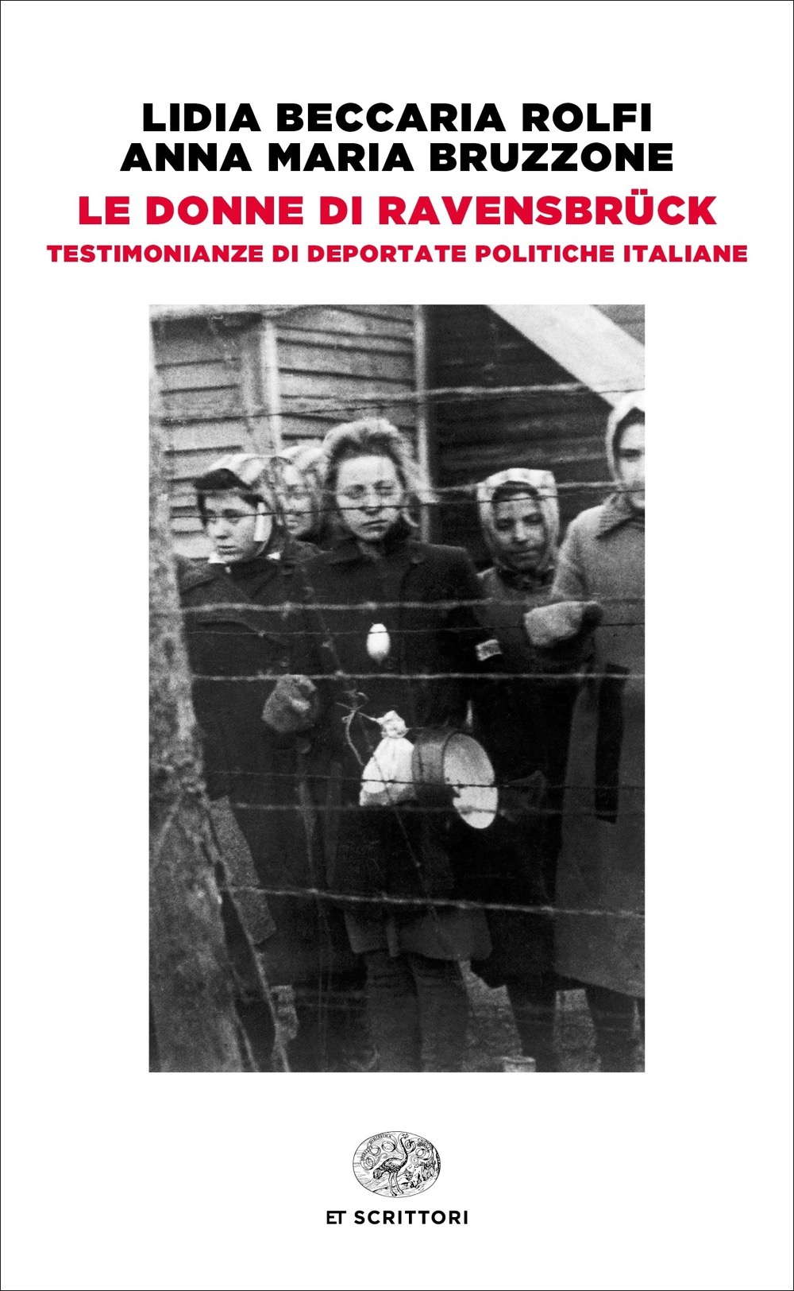
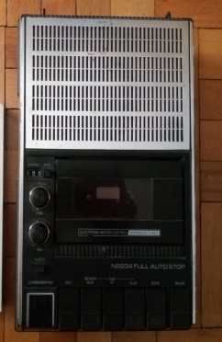
Anna Maria Bruzzone and Lidia Beccaria Rolfi, 1977
L. Beccaria Rolfi - A.M. Bruzzone, Le donne di Ravensbrück. Testimonianze di deportate politiche italiane, Torino, Einaudi, 1978 (2020)

Slide 5
The Italian archive The curation tasks*
Metadata description
Verbatim transcription
4 long interviews
14 audio cassettes with a total duration of about 18 hours and 20 minutes.
The analogue audio cassettes were digitized according to IASA standards (.wav format, 96000 Hz, 24 bit).
* Curation funded by CLARIN

Slide 6
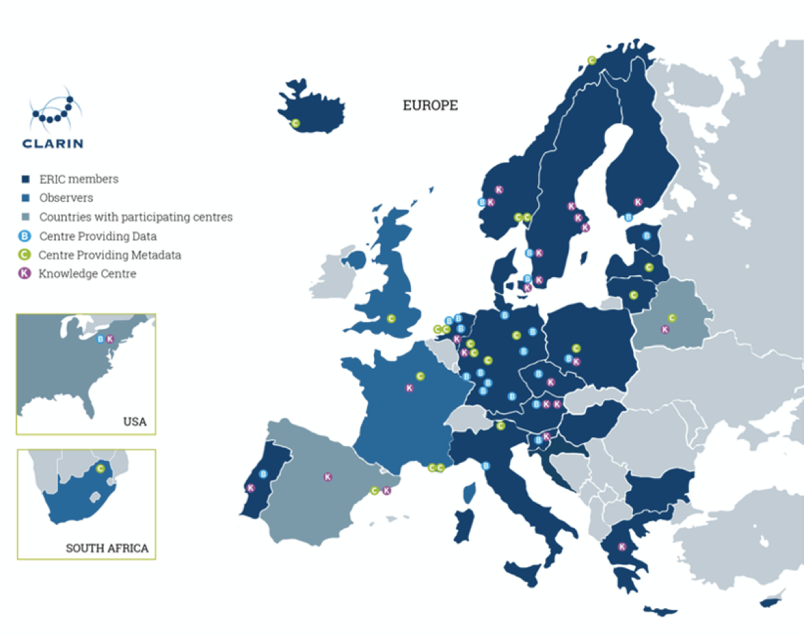
Oral Histories about Ravensbrück worldwide and CLARIN members
Imperial War museum
Museum of Dutch Resistance, Jewish Historical Museum, Getuigeverhalen
Polish video archive
Fortunoff Collection
Holocaust Memorial Museum Collection
German video archive
Austrian video archive
Catalan archive
Bruzzone/Rolfi archive
Shoah Visual History Collection
Notes:
/

