Slide 1

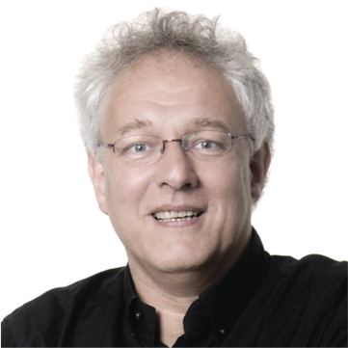
HLT & AI
Arjan van Hessen
Universiteit Twente
Universiteit Utrecht

Slide 2
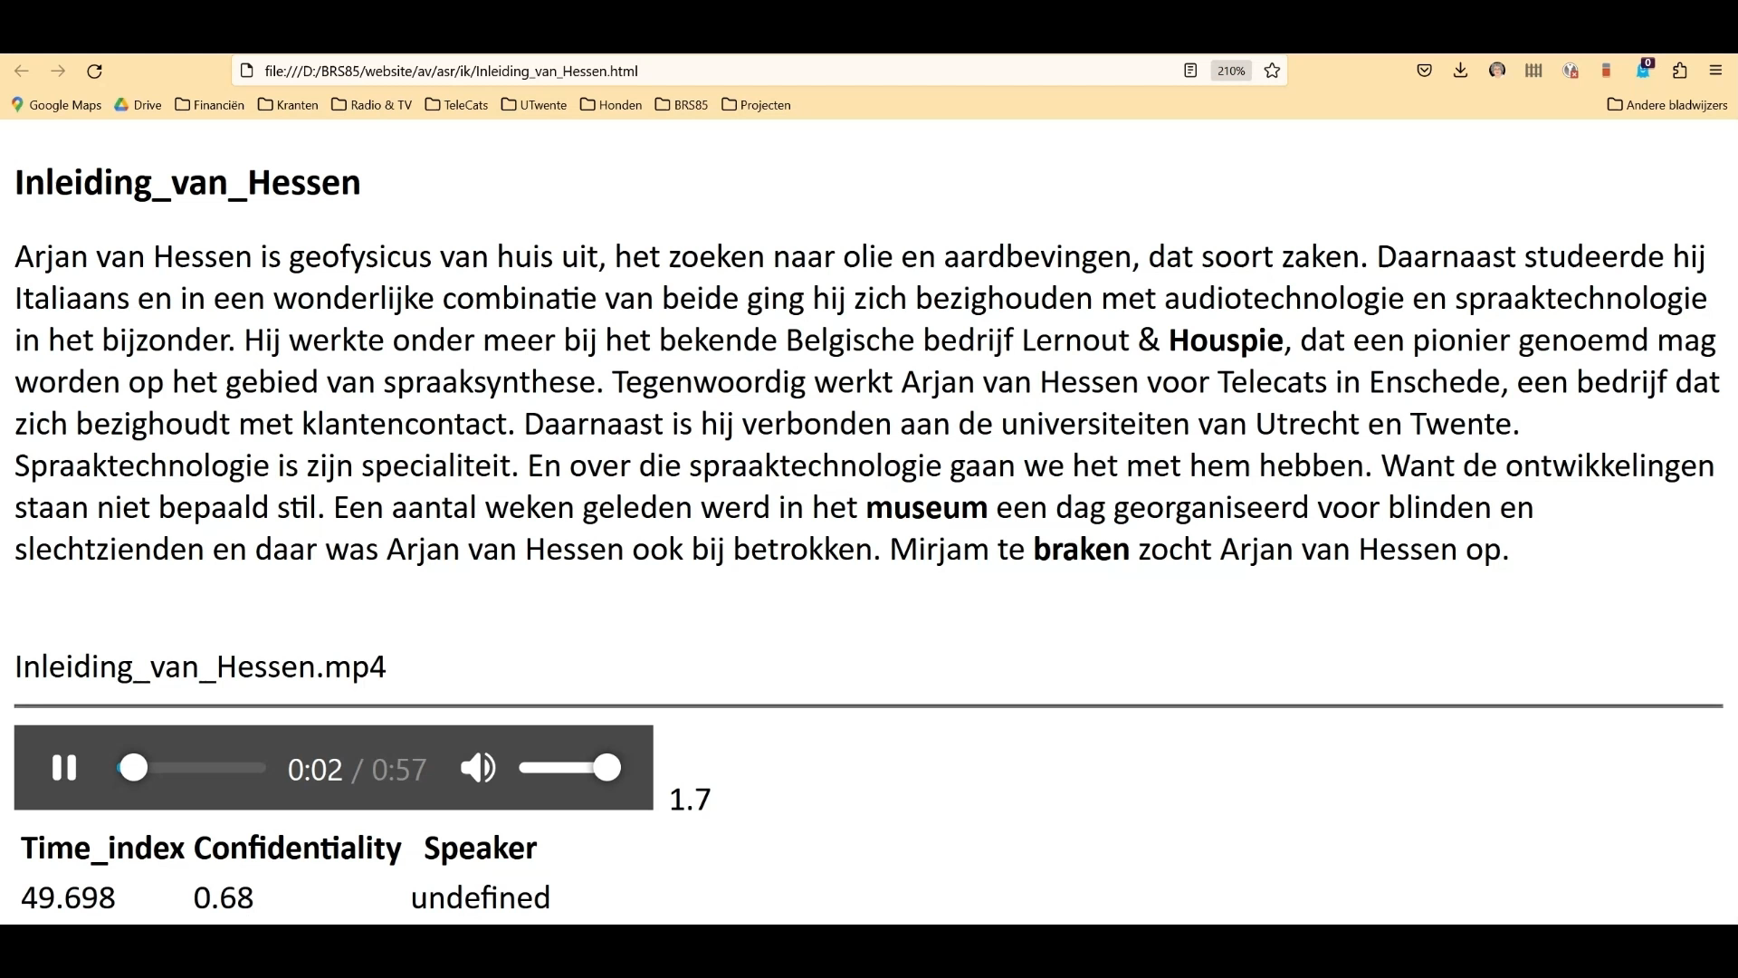

Slide 3
What will be discussed?
ASR, how does it work and what is still going wrong
Making your (own) audio-content suitable for ASR
Recognising your AV-recordings
ASR result: a table of words, times and confidentialities. What to do next?
Correcting the ASR results into what ???

Slide 4
Automatic Speech Recognition
How did it work till 1.5 years ago
How does it work now

Slide 5
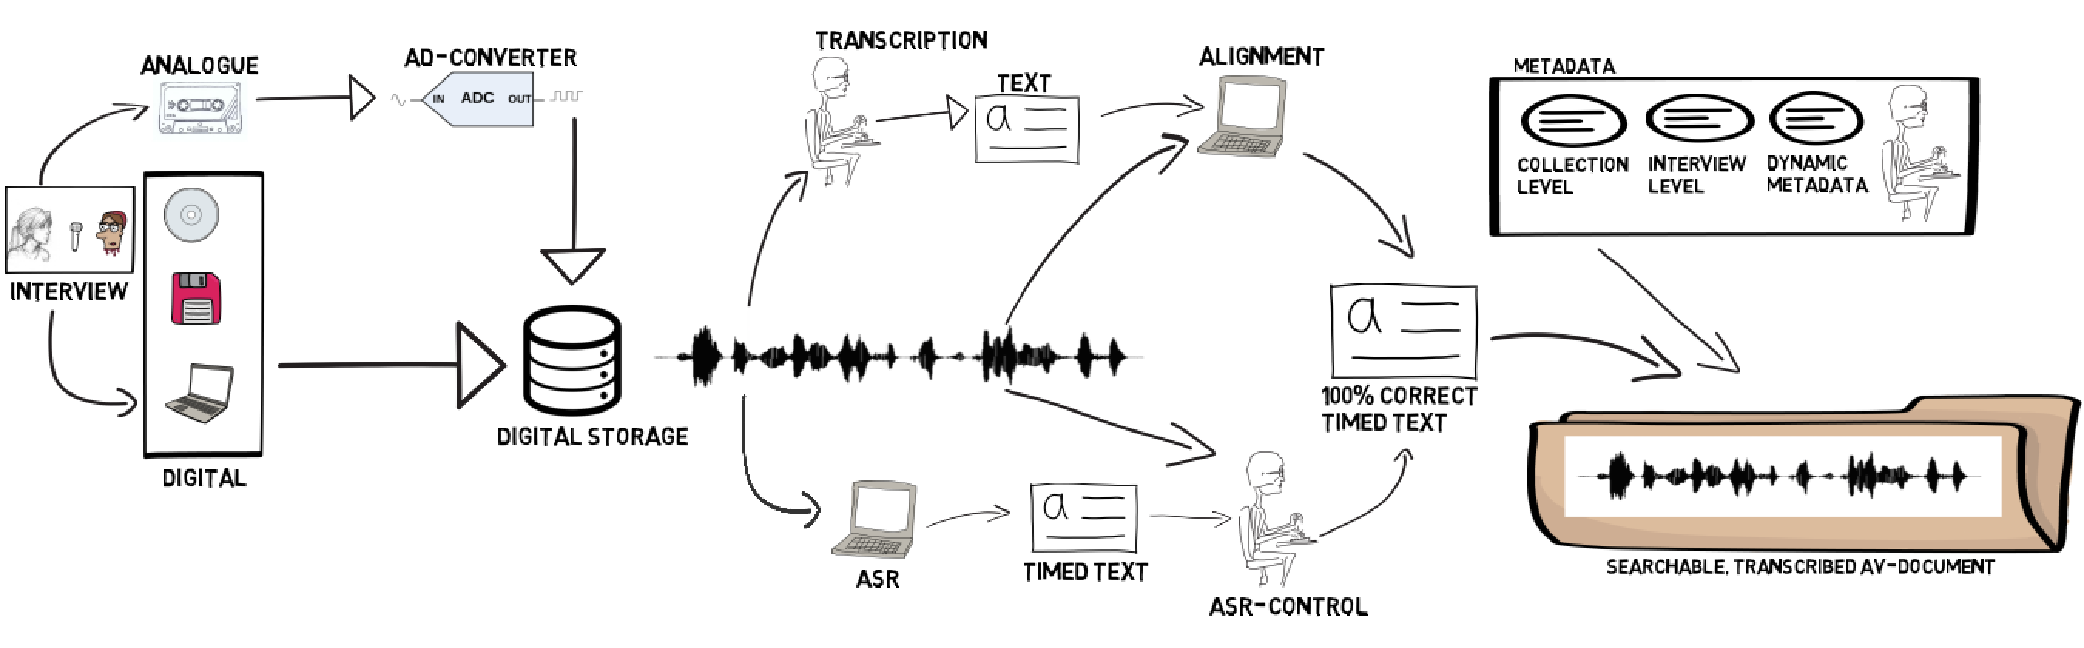
The Transcription Chain
5
1
3
4
2
3
Analog-Digital Conversion (ADC)
Automatic Speech Recognition (ASR)
Transcription correction
Synchronisation of Audio & transcription (Alignment)
Metadata

Slide 6
How did it work

Slide 7
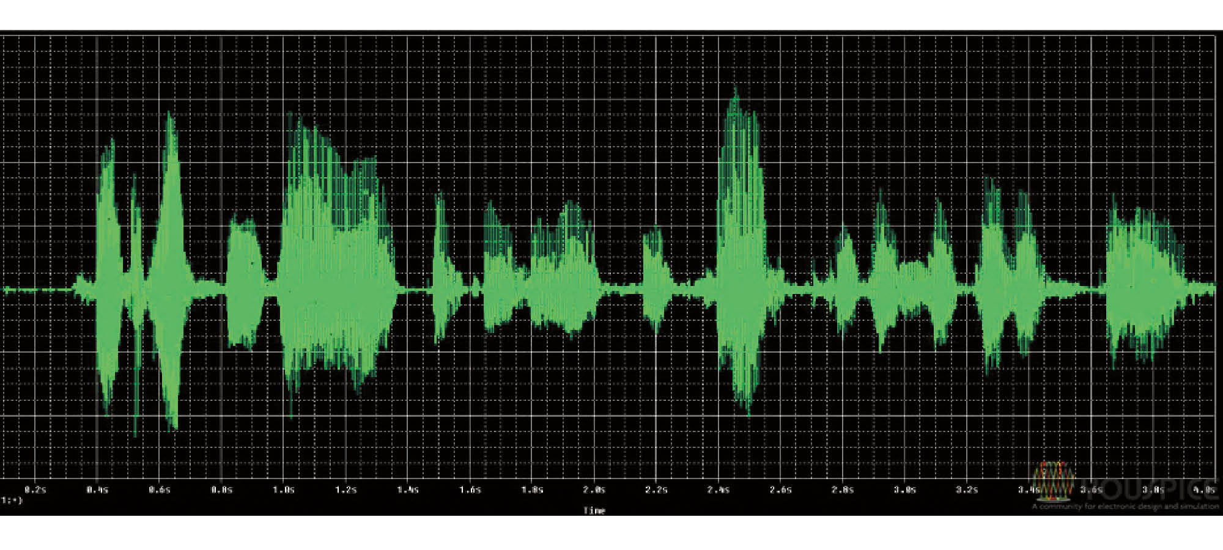
ASR
/w/
/E/
/l/
/k/
/O/
/m/

Slide 8
ASR
Phonetic graph for the utterance of the Swedish word “Waxholm”
Vaksholm
Vaksolm
Veksoln
Veksholn
Veksholm

Slide 9
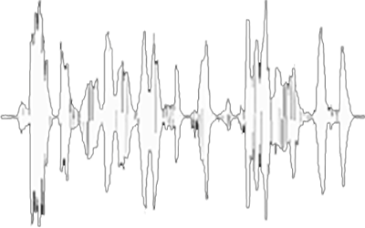
ASR
Wreck a nice beach
Recognise speech
But… which words?

Slide 10
Language model
To predict what will be said

Slide 11
Language model
home (6720K)
forward (5770K)
I’m going xxx
nuts (1300K)
berserk (128K)
backward (35K)

Slide 12
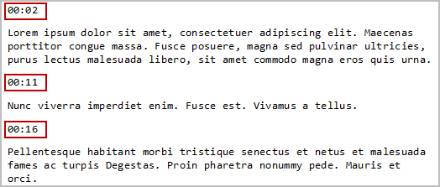

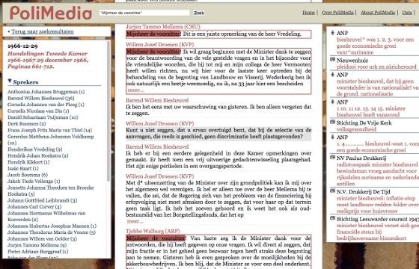

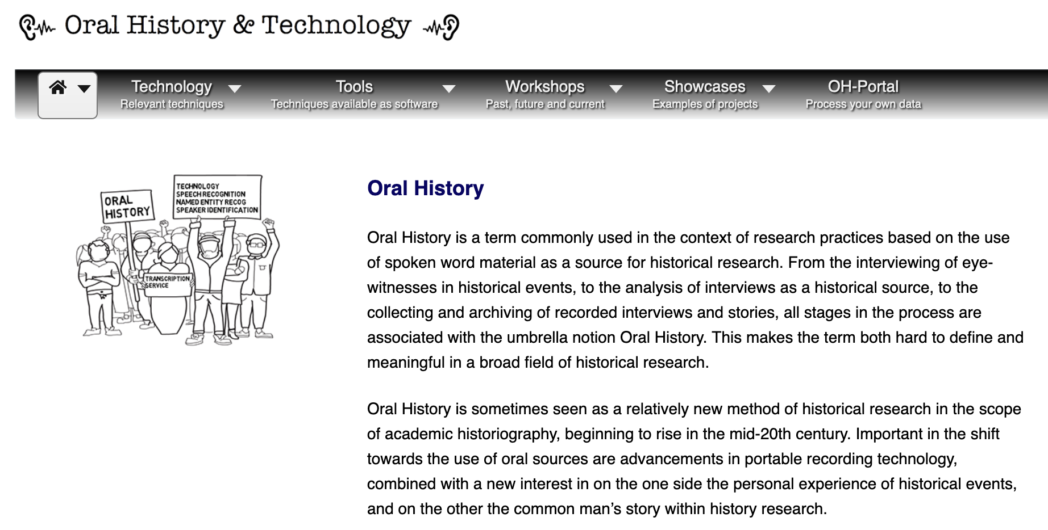
Language model
Collect text that represents the way your audience speaks

Slide 13
Language model
Collect all the relevant text
Clean the text and store it in UTF-8
“Uniform” the writing of the words
Decompound the less frequent words
  Obersturmbannführer -> Ober + sturmbann + führer
  voetbal -> voet + bal

Slide 14
Language model
Convert numbers into words (but which..?)
  My bank account is 7162543 (716.25.43)
  My salary is 7162543 (7.162.543)
  My phone is 7162543 (71 62 5 43)
Abbreviations:
  I cycled on the dr. Martin Luther King dr.

Slide 15





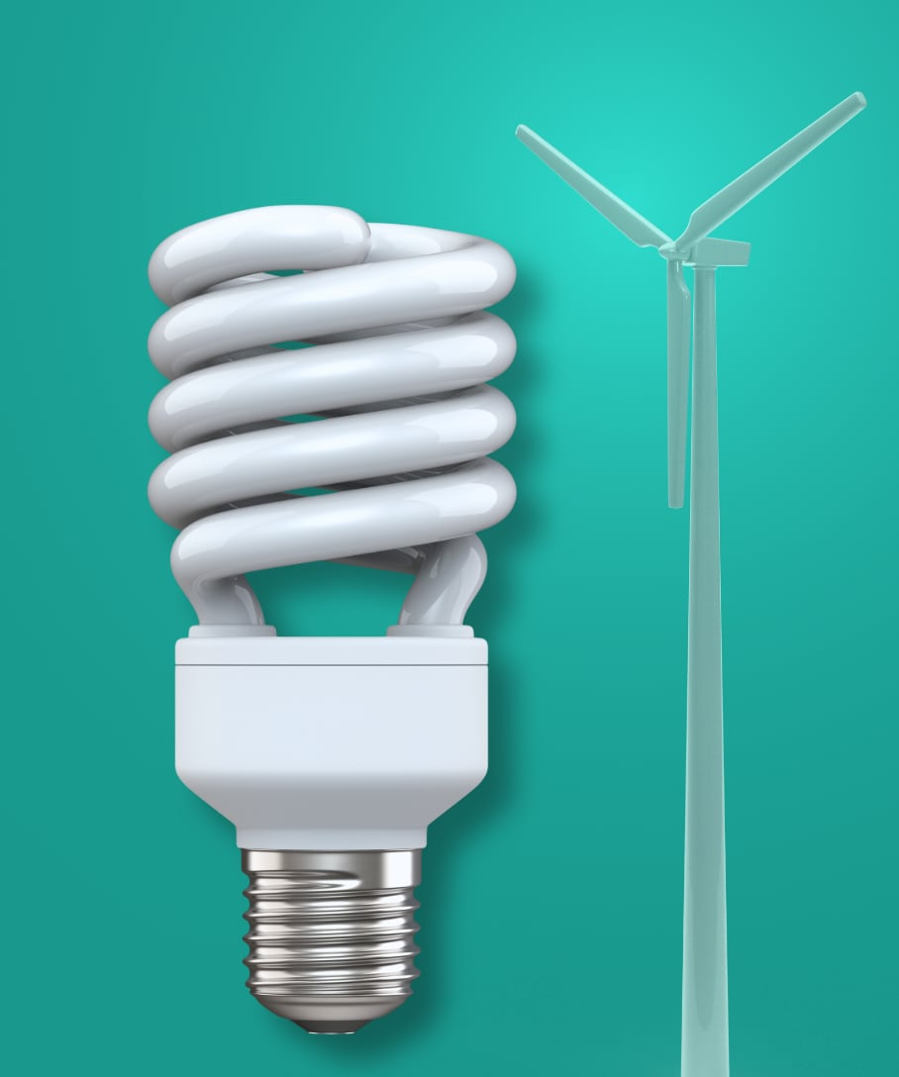
Context Depended Language Model
Generally, physicians respond with a variety of emotions to their patients: some they truly like; others they do not like but still regard sympathetically because of their illnesses. In rare instances, however, a doctor actually hates a patient yet is forced to take care of him or her. That happened to me in one case when I was an intern.
Over a period of several years, one of the most infamous patients in our hospital was referred to as "Duchess," a nickname bestowed by the hospital staff. A fifty-two-year-old female who suffered from chronic kidney failure, Duchess was on peritoneal dialysis. This treatment not only demands very careful medical management by doctors but it also requires a lot of cooperation from the patients, who must monitor their diets and fluid intake. Patients on peritoneal dialysis come to the hospital to be dialyzed
Text Processor
Context
Context
Context

Slide 16
Acoustic model
How are people talking

Slide 17
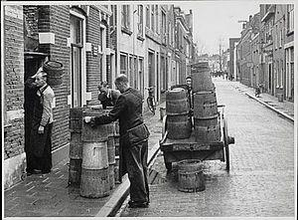
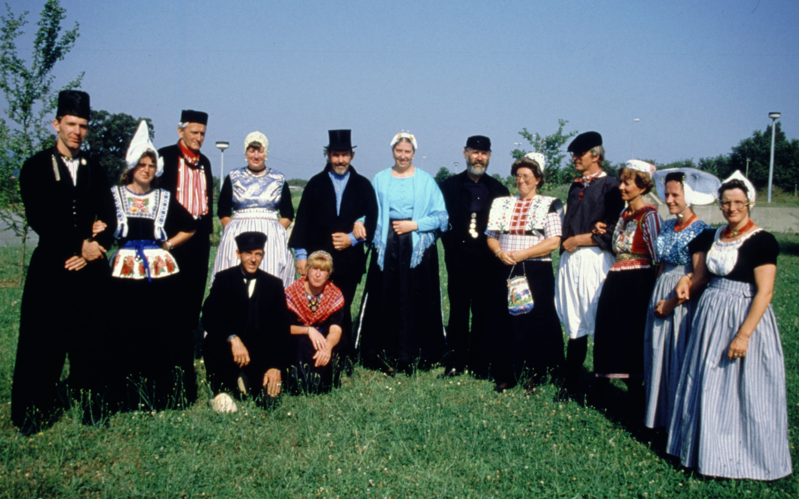
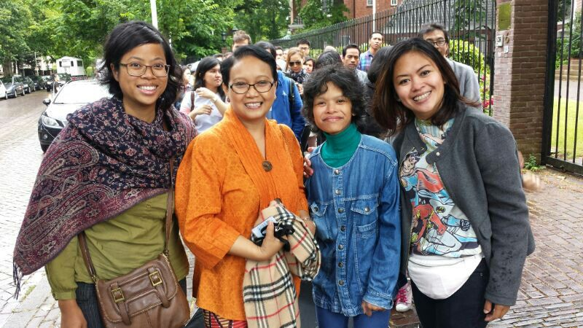
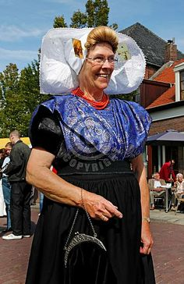
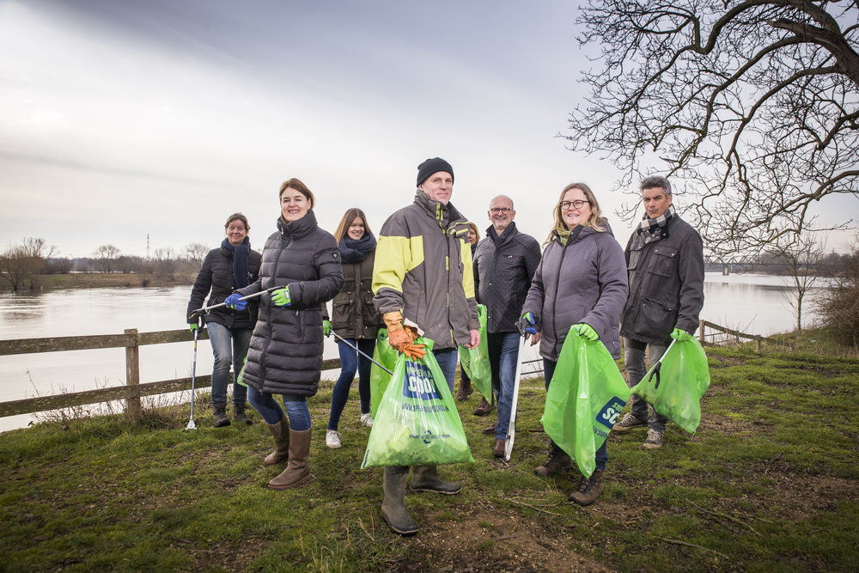
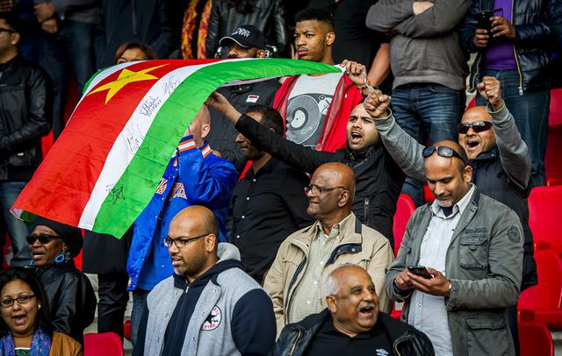
Acoustic model (NL)

Slide 18
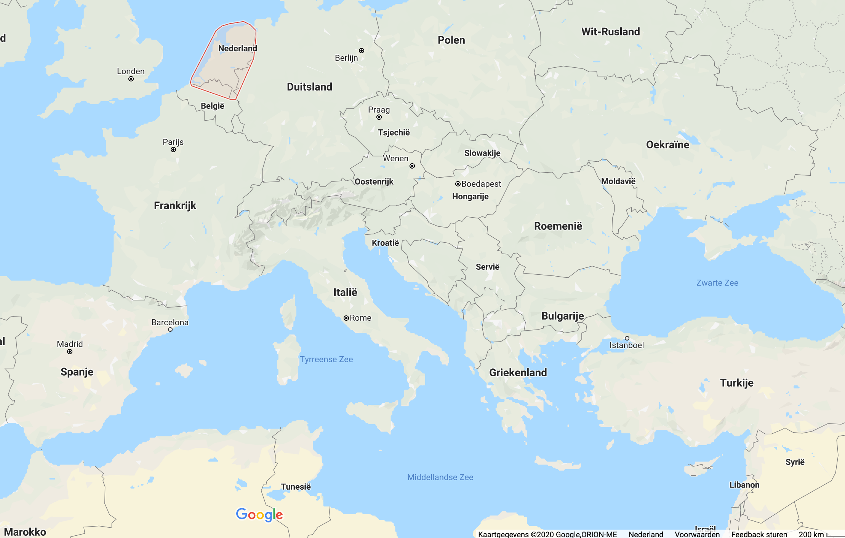
Acoustic model (NL)
After 1990
After 2020
After 1950
After 1970
After 2010

Slide 19
Acoustic model (NL)
Collect speech samples
Transcribe it verbatim
Select the words
Select the phonemes of each word
Adapt the acoustic model

Slide 20
ASR

Slide 21
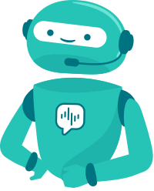
Currents state of ASR
Voicebot
TTS – ASR
Chatbot
Conversational
optimal conditions
speak
listen
Artificial intelligence
95%
HUMAN ACCURACY
62%
70%
60%
2024
50%
55%
1970
1980
1990
2000
2010
2020
2030
DEEP NEURAL NETWORKS
ARTIFICIAL INTELLIGENCE
Notes:
Voice bots zijn net iets complexer dan chatbots. De ontwikkel;ing gebeurd nu vooral op tasasl gebied.

Slide 22
What is going wrong?
Acoustic misfit
Spoken words
Background noise

Slide 23
What is going wrong?
Way of speaking
Grammatical errors
ASR errors
Unknown words
Too much background

Slide 24
What is going wrong?
Way of speaking
ASR errors
Convince people to speak differently
Adapt your
language model
Prevent background noise as much as possible
Grammatical errors
Unknown words
Too much background

Slide 25
Making your audio-content suitable for ASR
AD-conversion
Transcoding
Audio ripping

Slide 26
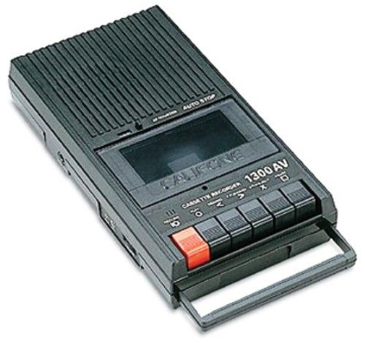
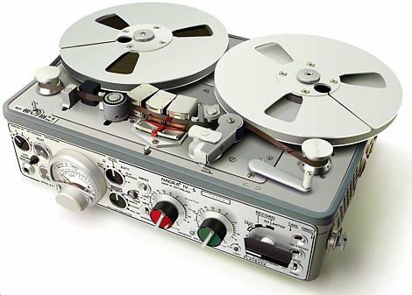
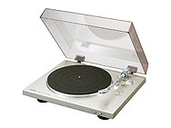
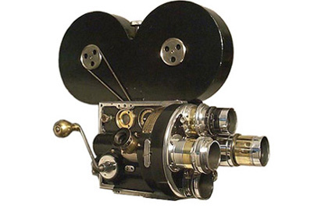
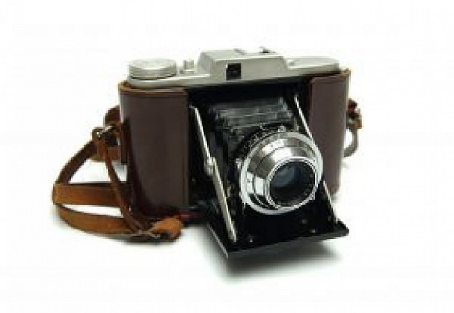
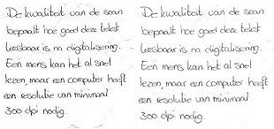
Analogue-Digital-conversion
Audio
Use the highest options for the first conversion
Store this version in an archive
Convert it to a low, more suitable format for elaboration
(Moving) images
Text

Slide 27
FFMPEG
You can use nearly every audio or video file
FFMPEG turns it into a suitable format for recognition.
The format of the AV-file is no longer important
See: https://github.com/FFmpeg/FFmpeg

Slide 28
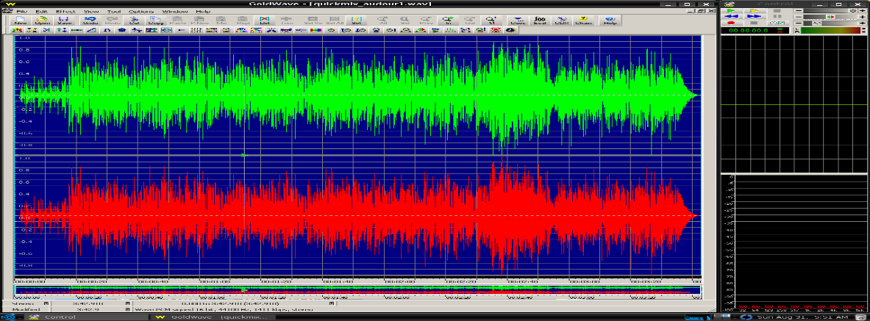
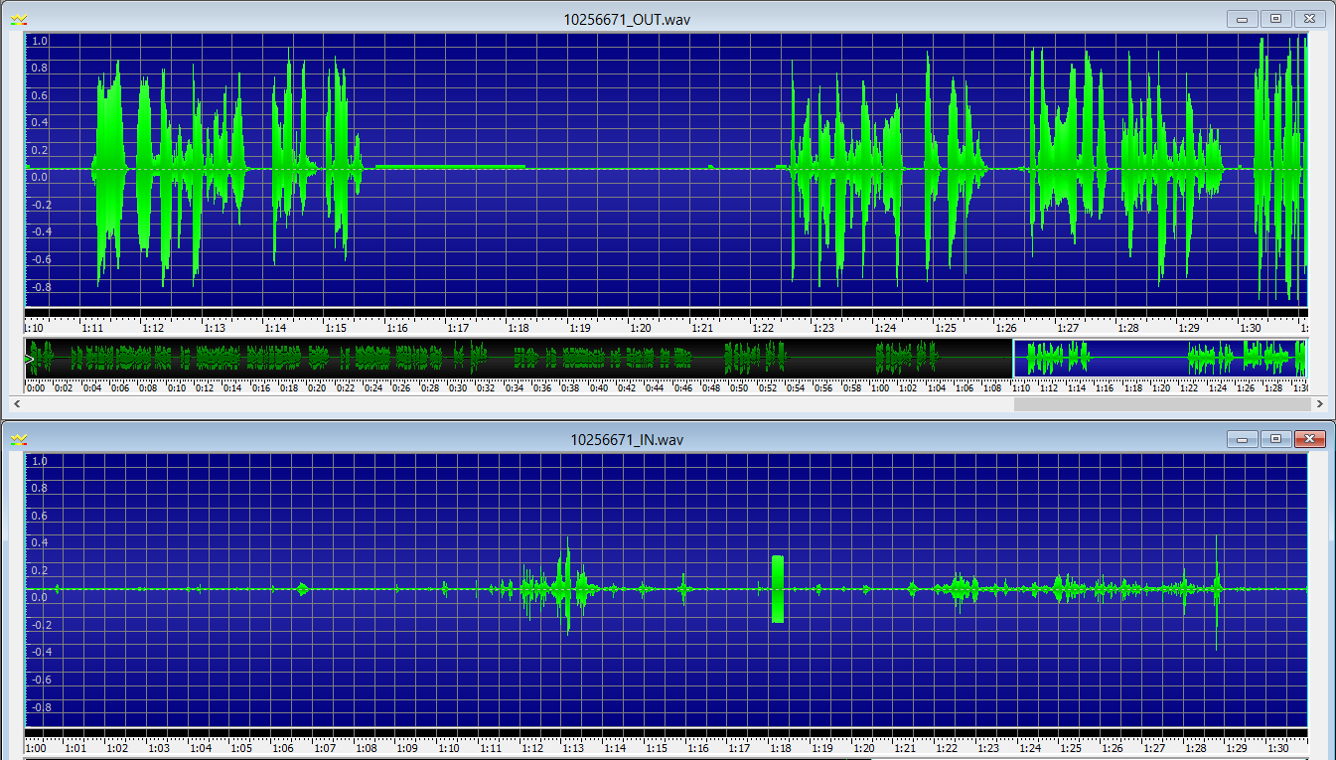
Mono or Stereo?
When there is no or just a small difference between the 2 (original) stereo channels, it is better to store it as mono.
When one speaker is on the left-, and the other on the right-channel, it is better to record it in stereo.

Slide 29
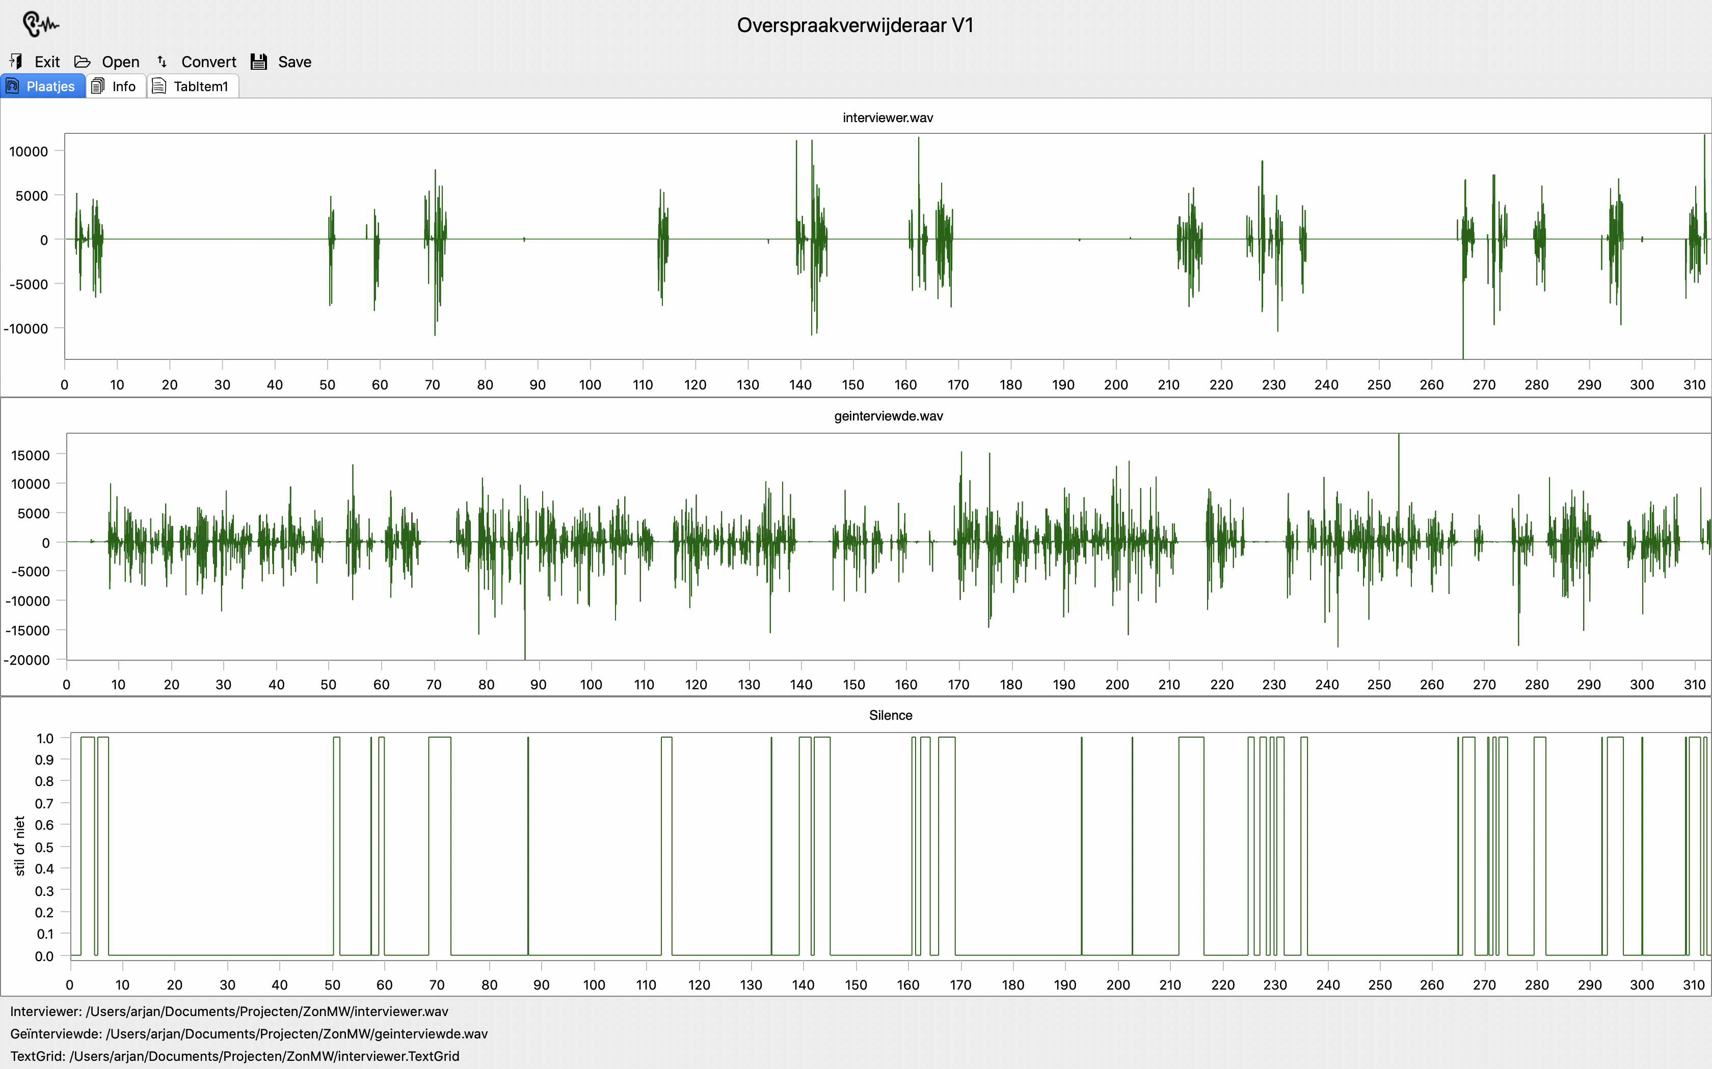

Mono or Stereo?
Difficult to hear
ASR very good
Impossible to hear
No ASR
PRAAT: annotate with silence

Slide 30
Recording new interviews
Keep (social) distance to prevent crosstalk
Record in stereo (or a speaker per channel)
Use HQ equipment

Slide 31
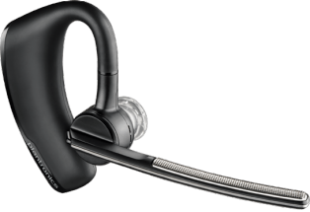
High quality
At least 16 kHz (for speech)
At least 16-bit (for the amplitude)
Stereo or, if possible, one speaker/channel
Use headsets also in case of video’s
Put your smartphone on soft tissues
Keep max distance between interviewer and interviewee

Slide 32
Recognising your own
AV-recordings
In the cloud
On the servers of your group/faculty
On your own computer(s)

Slide 33
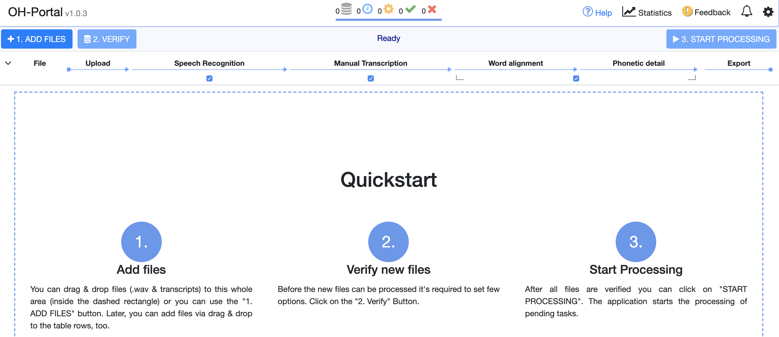
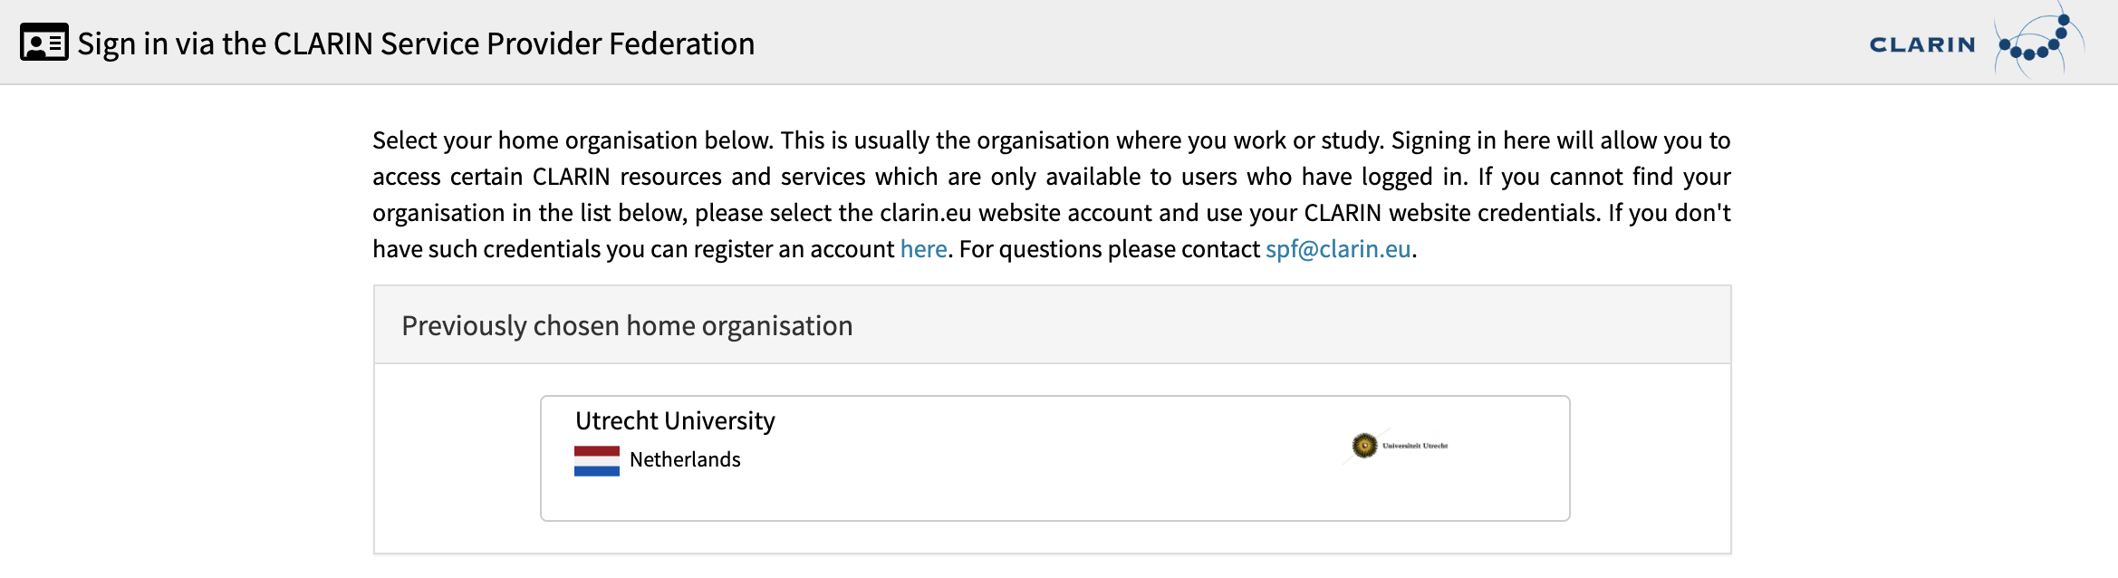
Registration
https://clarin.phonetik.uni-muenchen.de/apps/TranscriptionPortal/

Slide 34
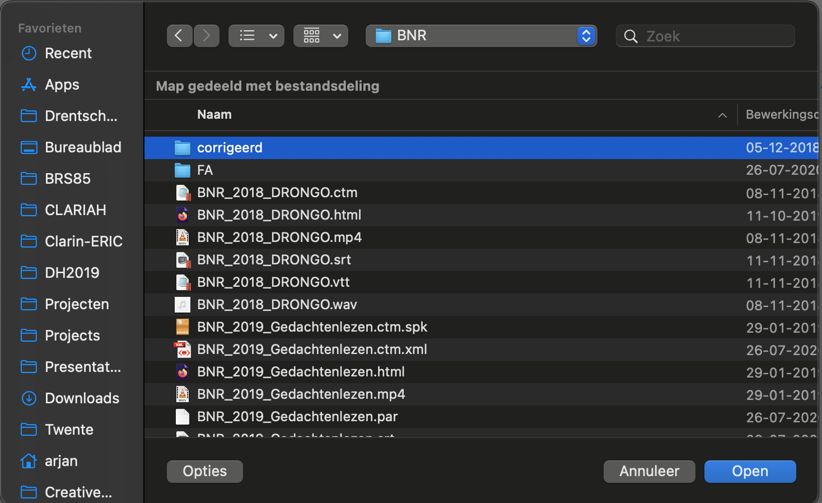
Recognition
https://clarin.phonetik.uni-muenchen.de/apps/TranscriptionPortal/

Slide 35
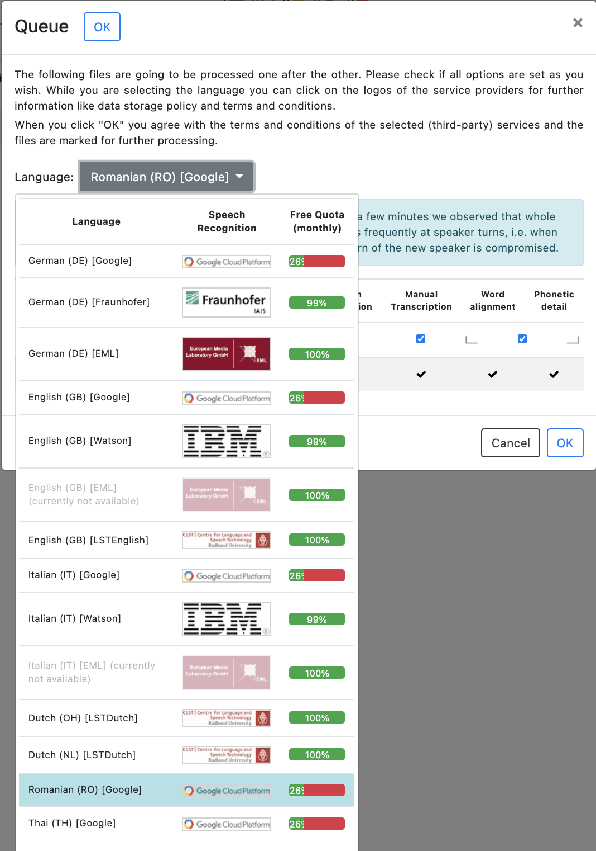
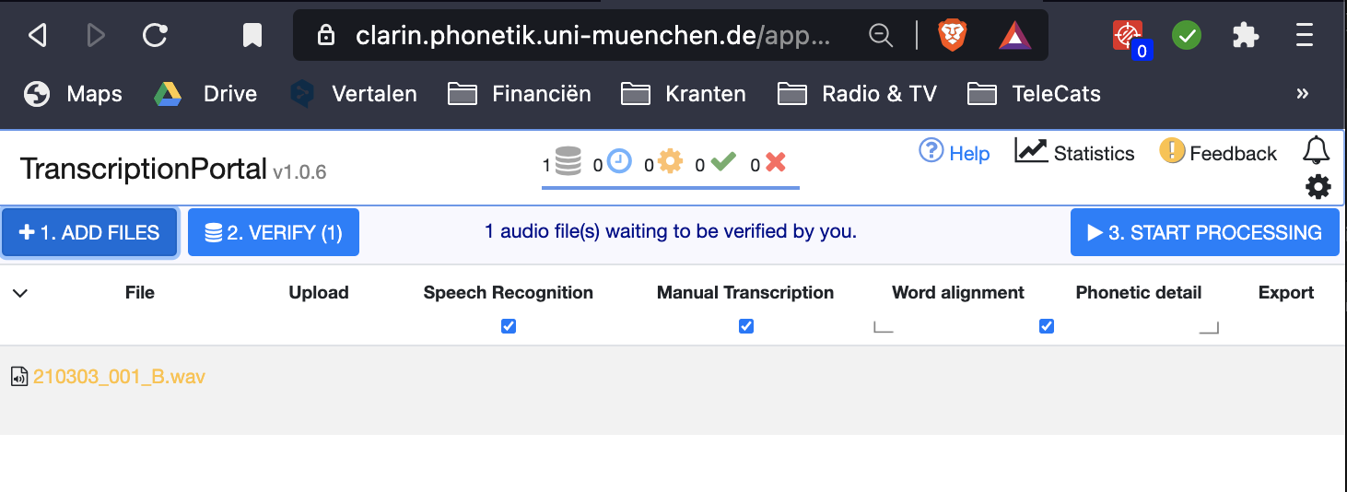
Recognition
Whisper
Language
Model
Device (CPU/GPU)

Slide 36
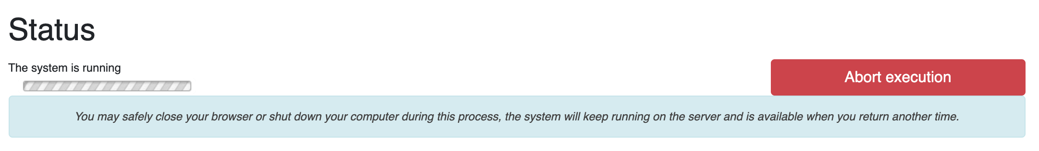

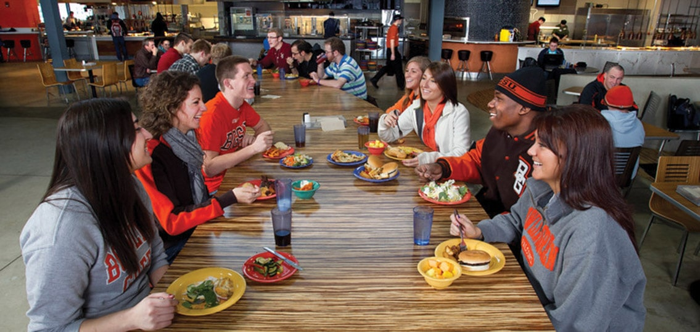

Recognition
Processing time ≈ 50% of the duration

Slide 37
ASR result: a table of words, times and confidentialities.

Slide 38
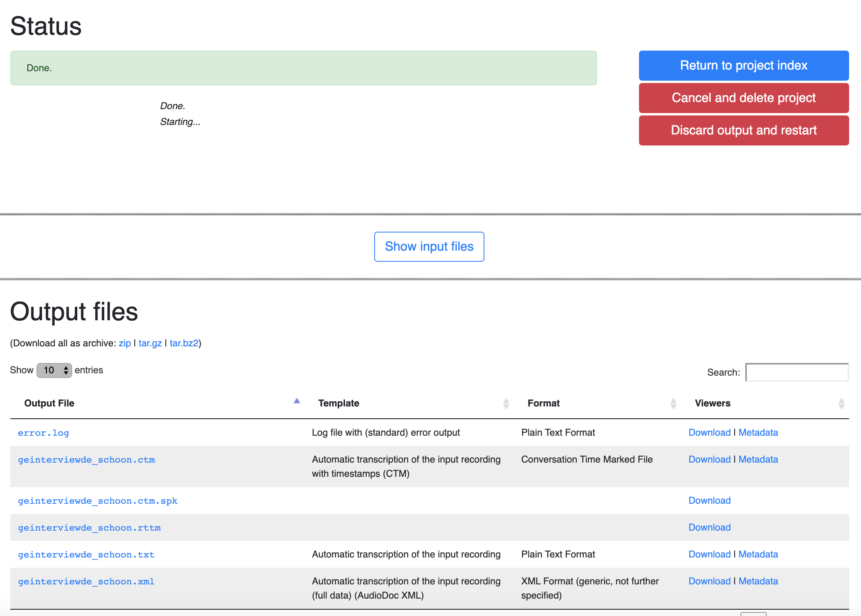
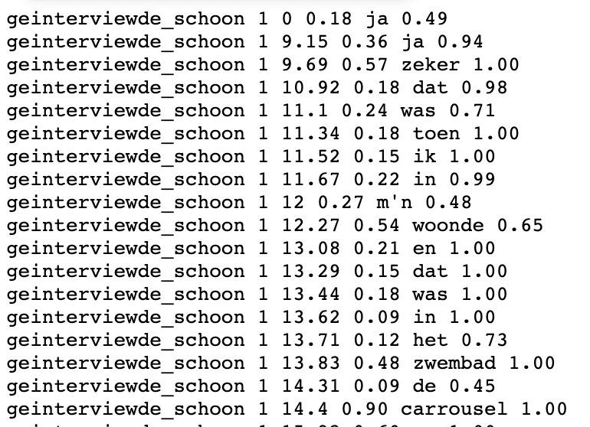
Recognition results
Confidentiality
Filename and ID
Start time & duration
Recognised word

Slide 39
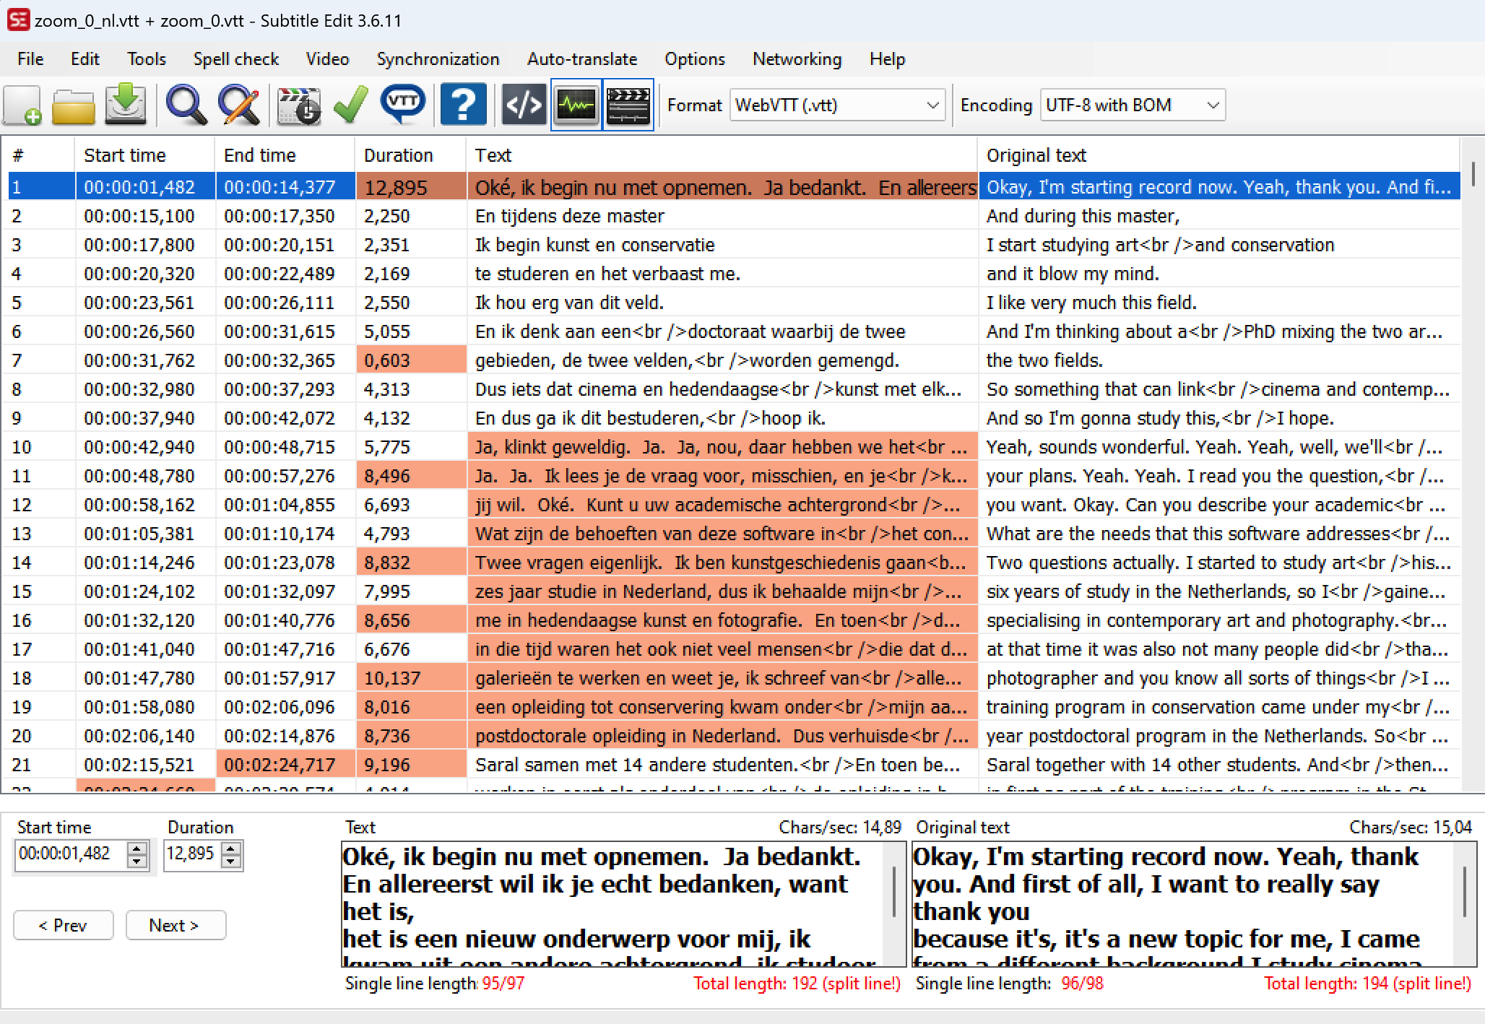
Automatic Translation

Slide 40
Future Current developments
Is the current ASR good enough?

Slide 41

End-to-End ASR
End-to-end is a system which directly maps a sequence of input acoustic features into a sequence of grapheme or words.
A trained an open-source neural net called Whisper that approaches
human level robustness and accuracy on speech recognition. (2022)

Slide 42
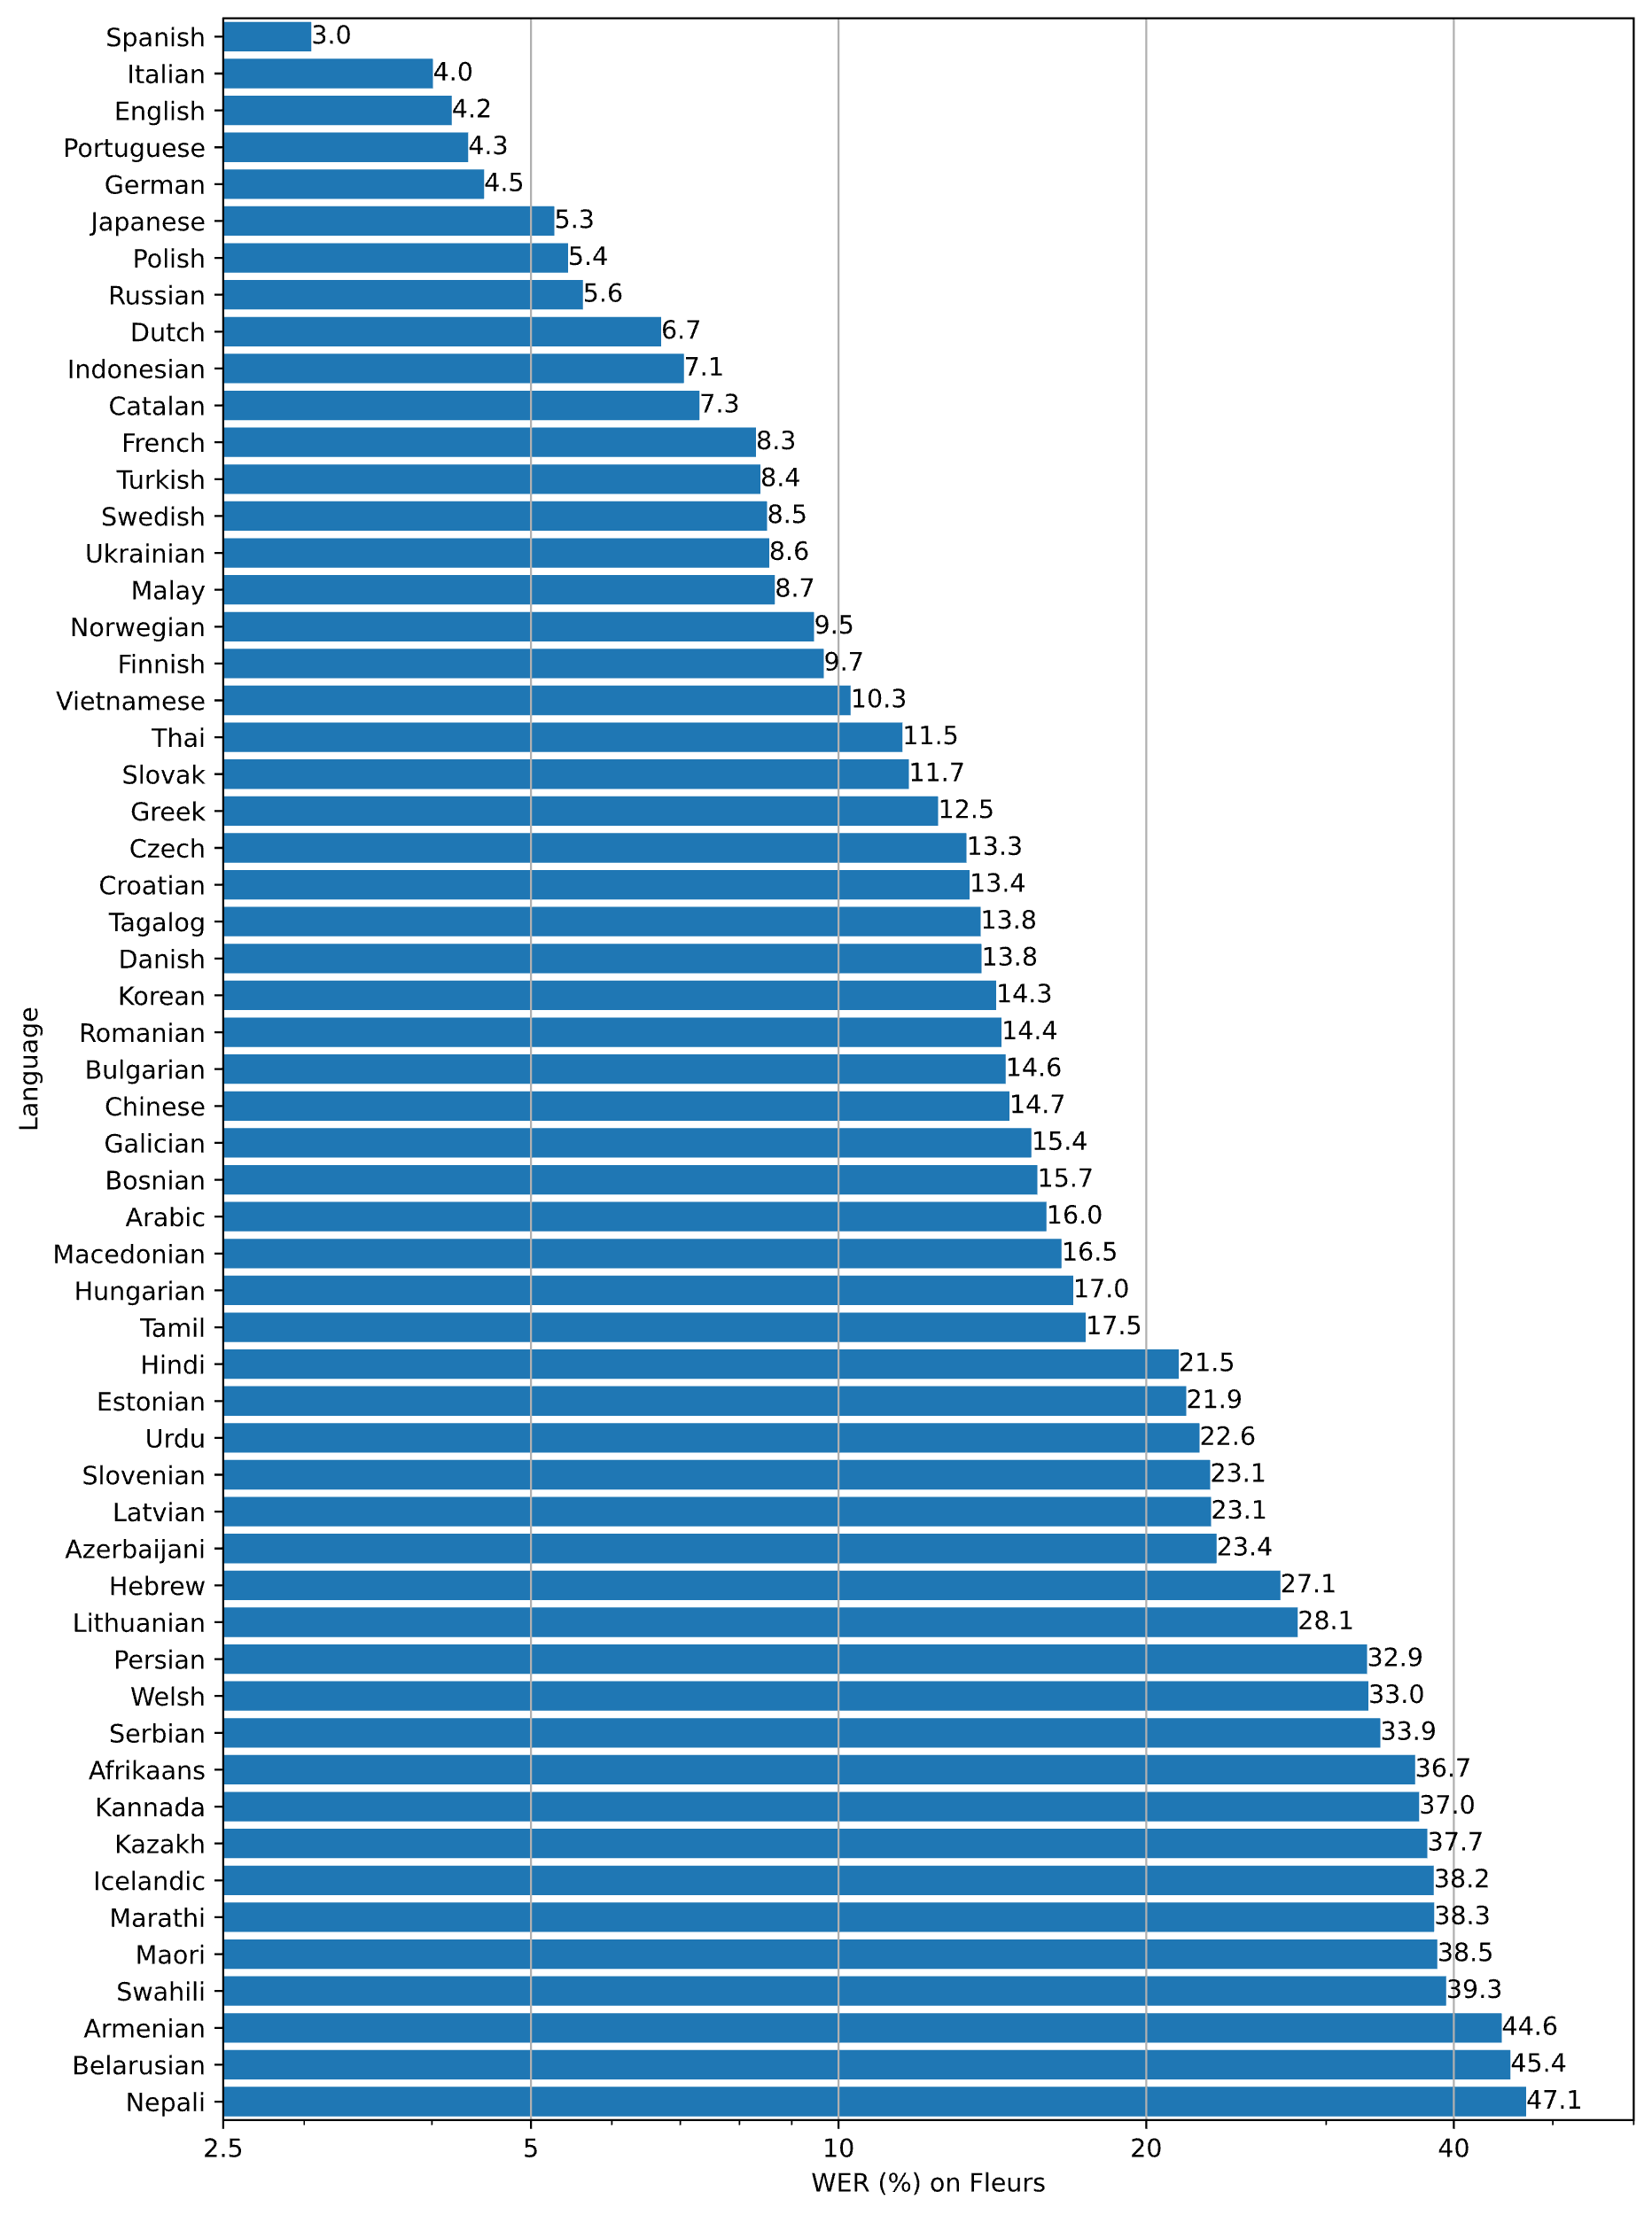
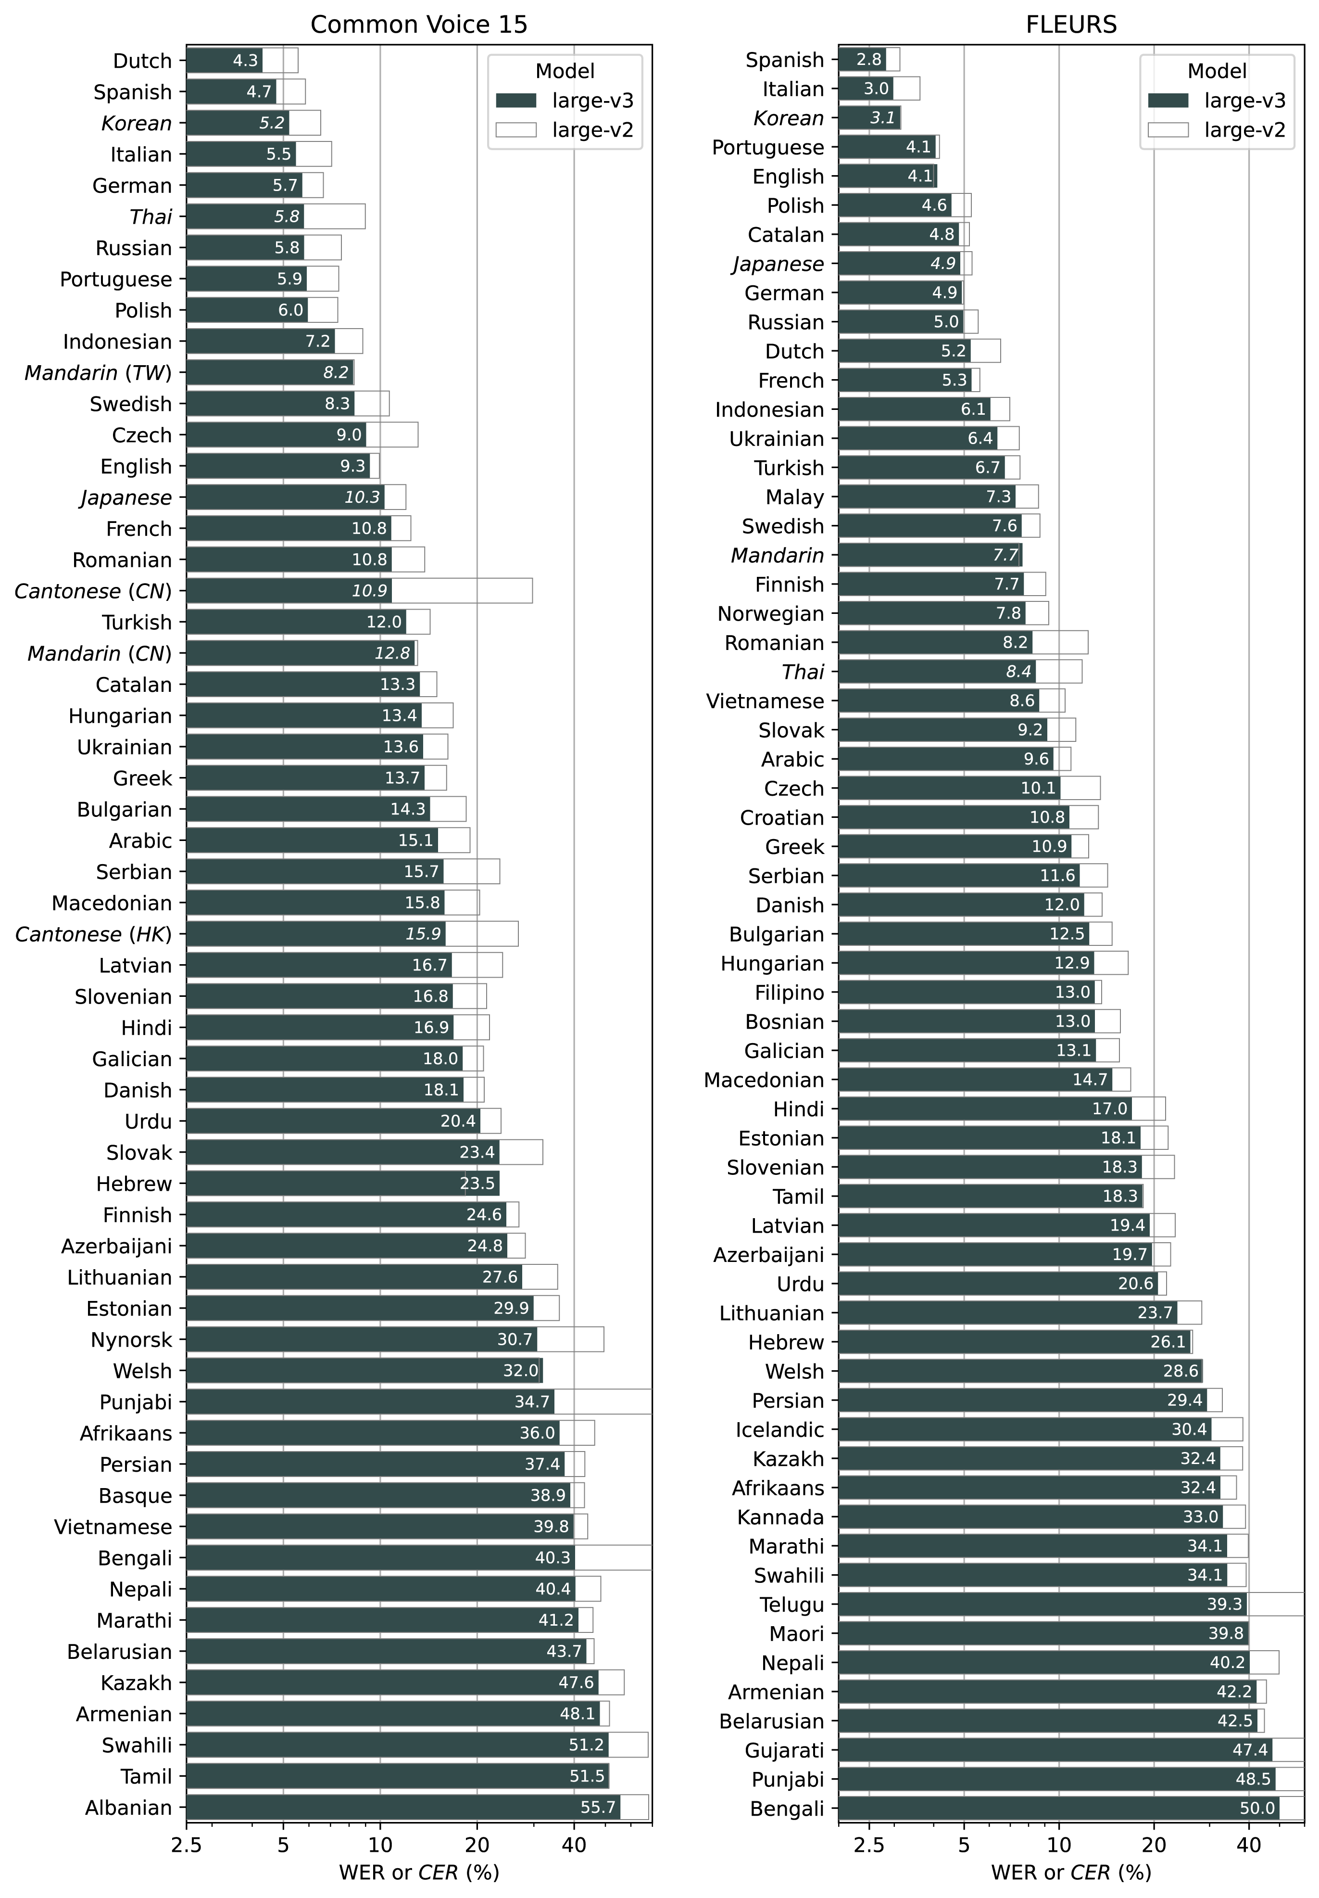
Languages
Dutch
German
Italian
…

Slide 43
Whisper
Recognition of 100 languages
Opensource
Can run on different platforms, at home, faculty or in the cloud
Outperforms (more or less) all other ASR models
See: https://github.com/openai/whisper

Slide 44
Opensource
One of the advantages of open source is that anyone who wants to (and is able to), can make his/her own improvements, additions or other tools and make them available again.
Whisper
WhisperX (diarizarion, VAD)
Fast-Whisper
(10x faster)
Whisper C++
Etc.

Slide 45
What to do next?
Install Whisper and “co-engines”
Start recognising

Slide 46
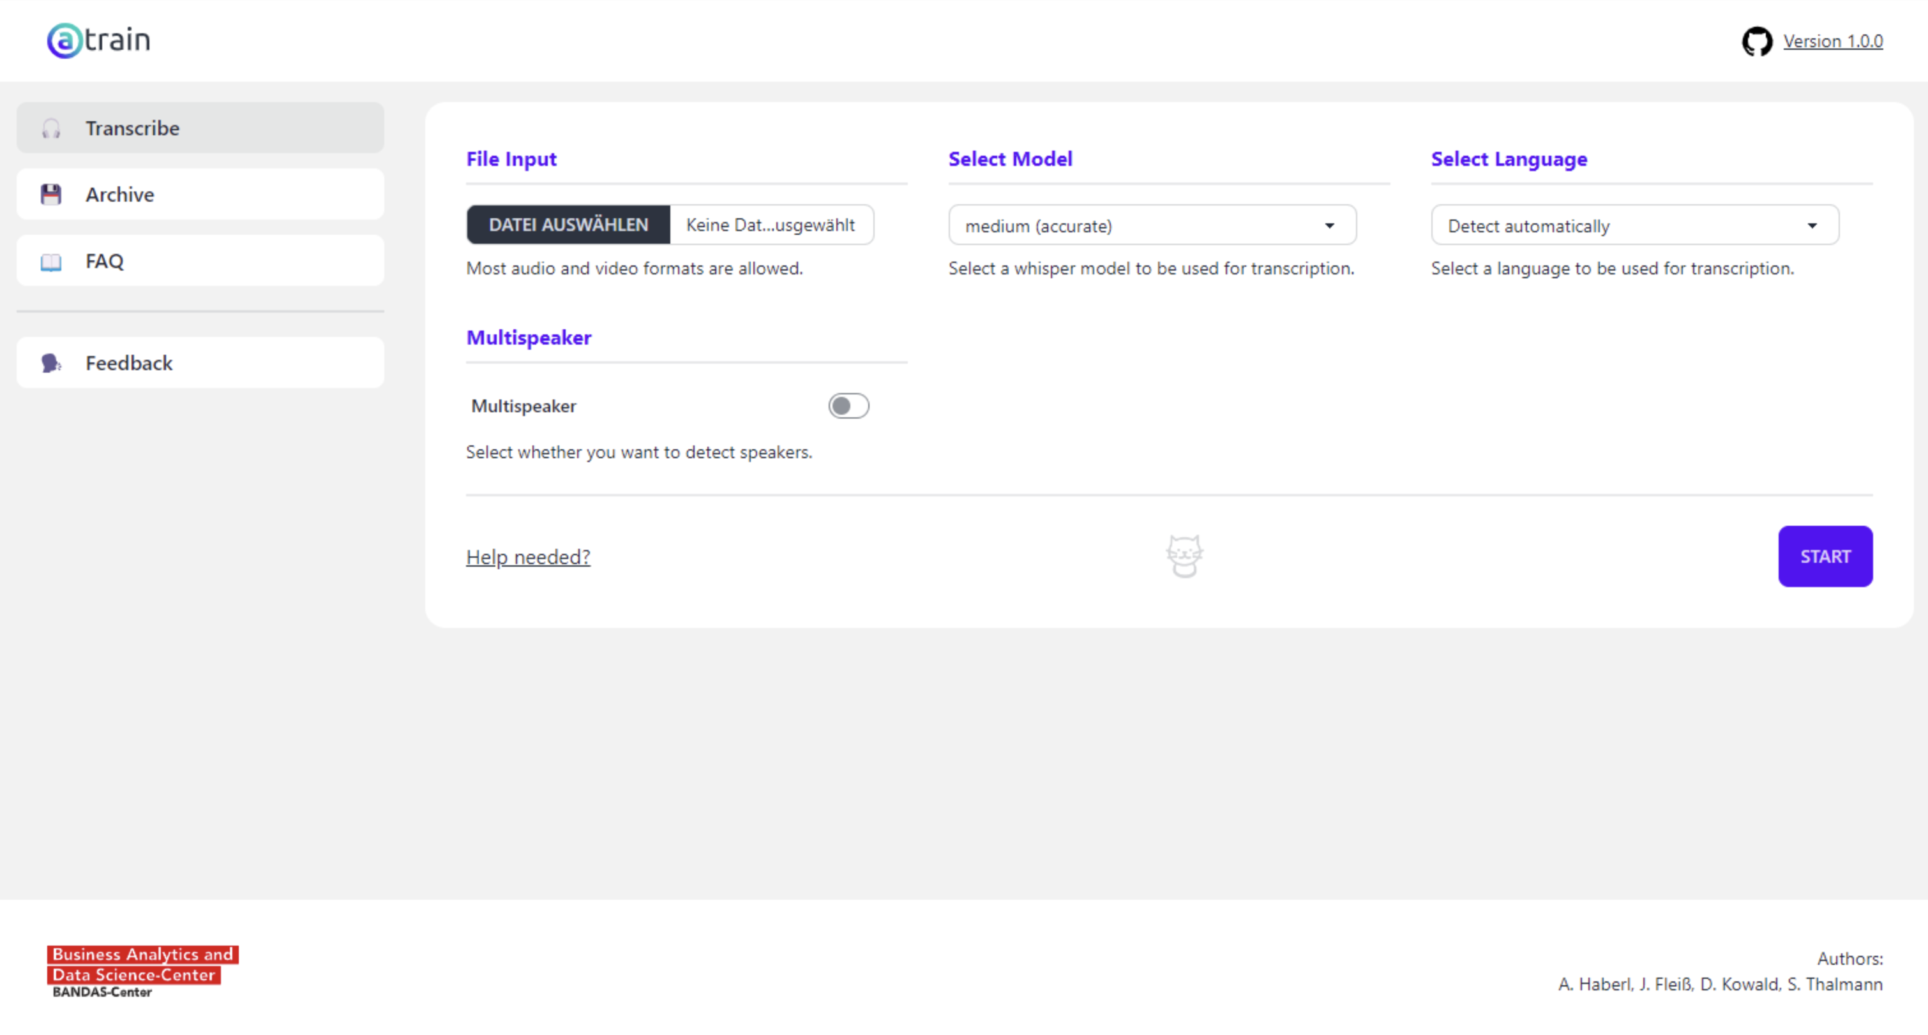

Dedicated engines
aTrain
https://apps.microsoft.com/detail/9n15q44szns2

Slide 47
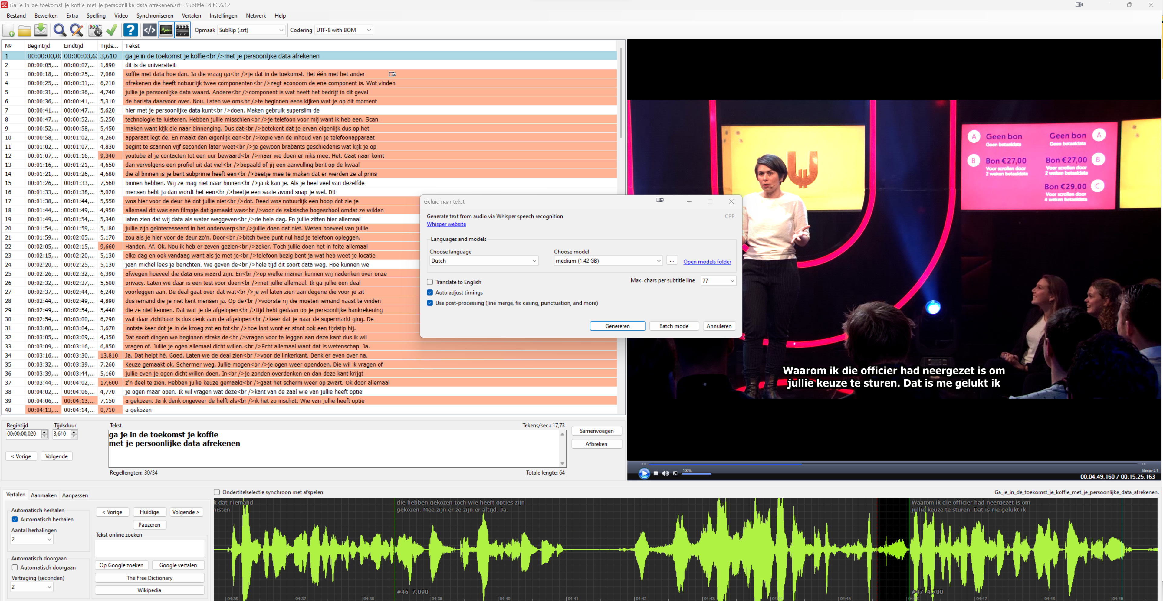
Dedicated engines
Subtitle Edit

Slide 48
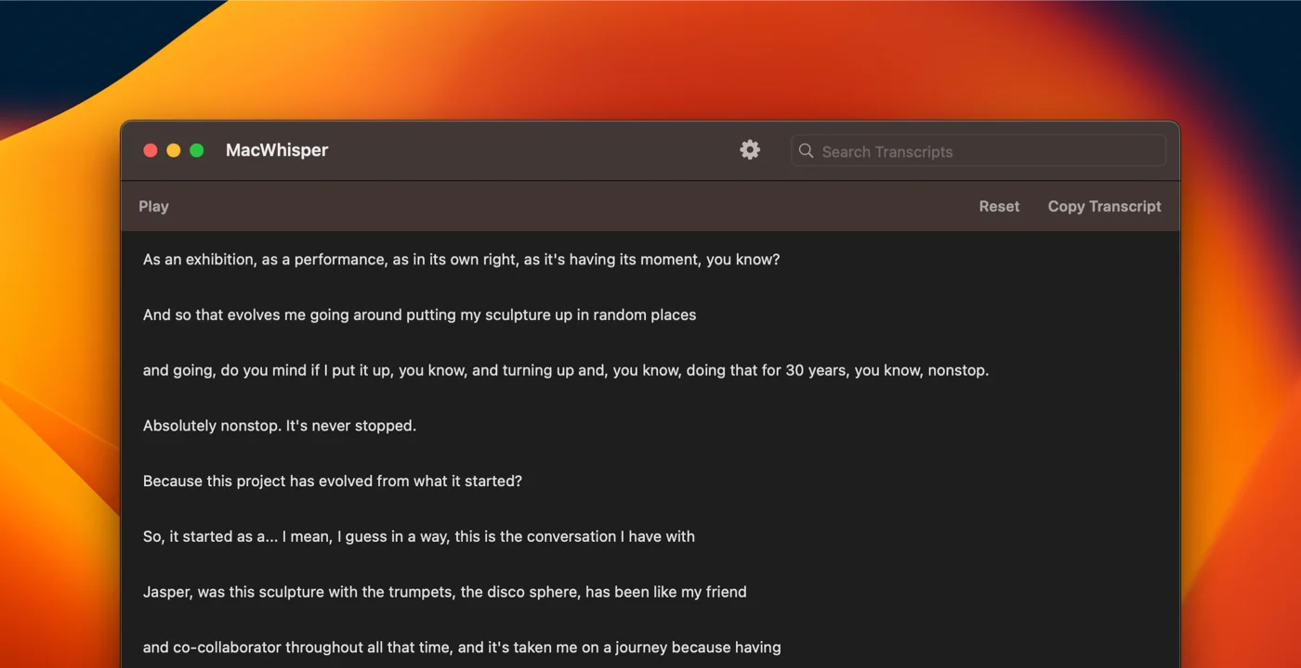
Dedicated engines
MacWhisper
https://goodsnooze.gumroad.com/l/macwhisper

Slide 49
Whisper
Use one of the existing programs
Install whisper.cpp (faster than whisper python without a GPU and much slower than with a GPU)
Install the right Python version (3.7 – 3.10)

Slide 50
Install Whisper(X)
Windows & OSX
  Python (3.7 – 3.10) https://www.python.org/downloads/
  PyTorch (1.10.1) https://pytorch.org/get-started/previous-versions/
  ffmpeg-python https://github.com/kkroening/ffmpeg-python
Whisper
  pip install git+https://github.com/openai/whisper.git
Eventually
  pip install git+https://github.com/m-bain/whisperx.git@v1.0.0

Slide 51
Correcting the ASR results
Into what?

Slide 52
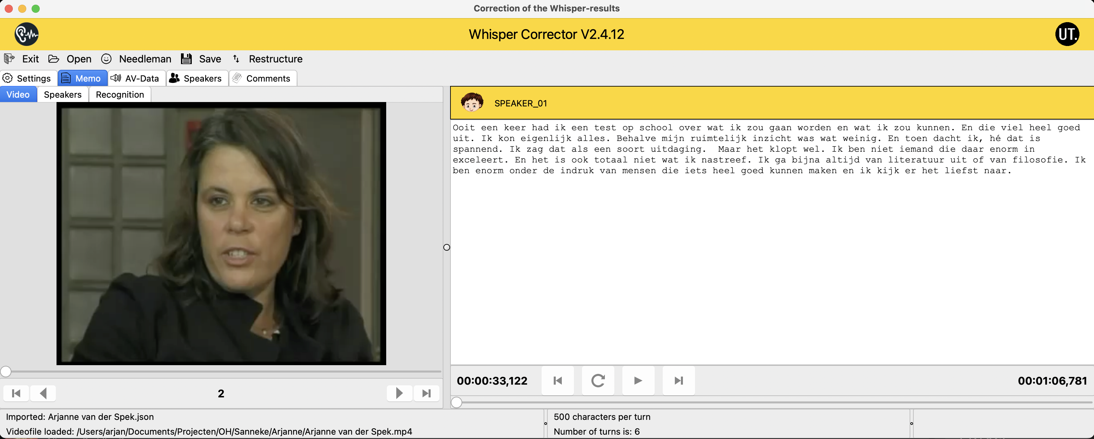
Correcting the ASR results
https://speechandtech.eu/tech-tools/software-developed-by-our-team#whispercorrector-how-can-i-correct-the-mistakes-within-an-automatically-generated-transcript-with-the-openai-whisper-engine

Slide 53
Correcting in to what??
What is the purpose of the transcription?
Verbatim
Close to the speech
Information
Grammatically correct
Natural Language Understanding
Doing it automatically
Extended summary
Summary
Time to transcribe

Slide 54
Forced Alignment
You have the transcript
You have the audio

Slide 55
Transcript alignment
Time-Aligned transcripts make it possible to search in the recordings and, if found, retrieve the searched fragment
Speech Recogniser
Human transcription
Transcript (text)
NO time codes
+
Respeaking
Speech file
ASR
Transcript (text)
+ time codes

Slide 56
Witness stories (NIOD)
More than 600 hours of Oral History about WWII searchable on the word level

Slide 57
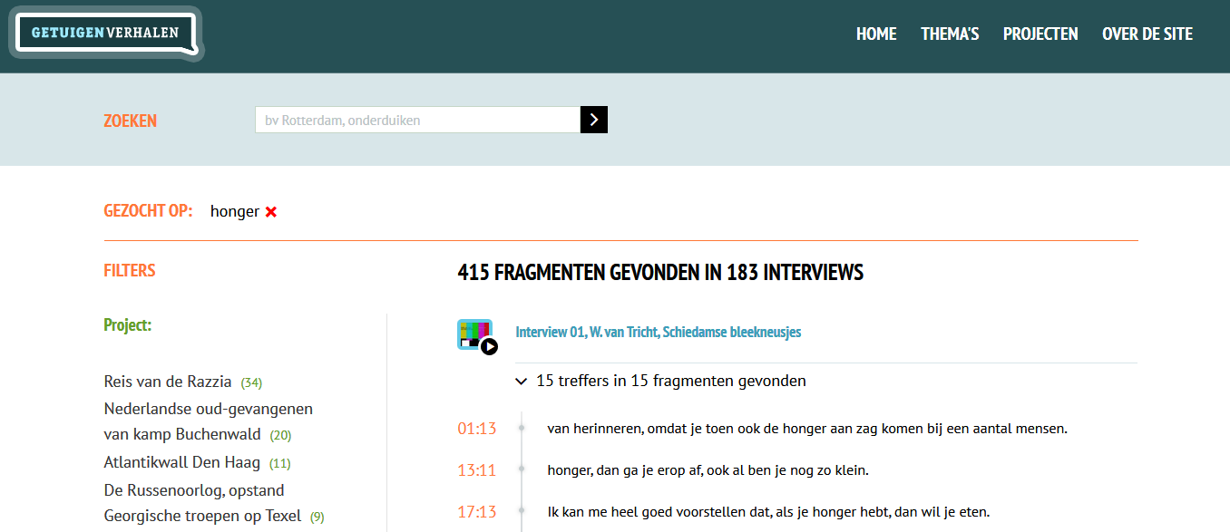
Example: witness stories

Slide 58
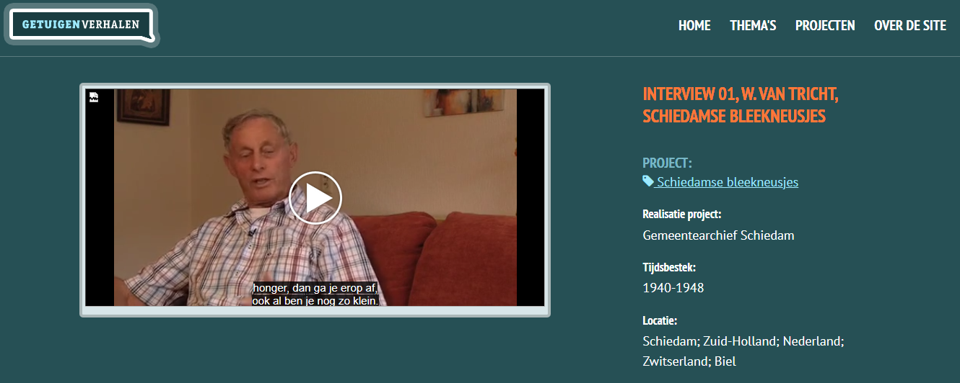
Example: witness stories

Slide 59
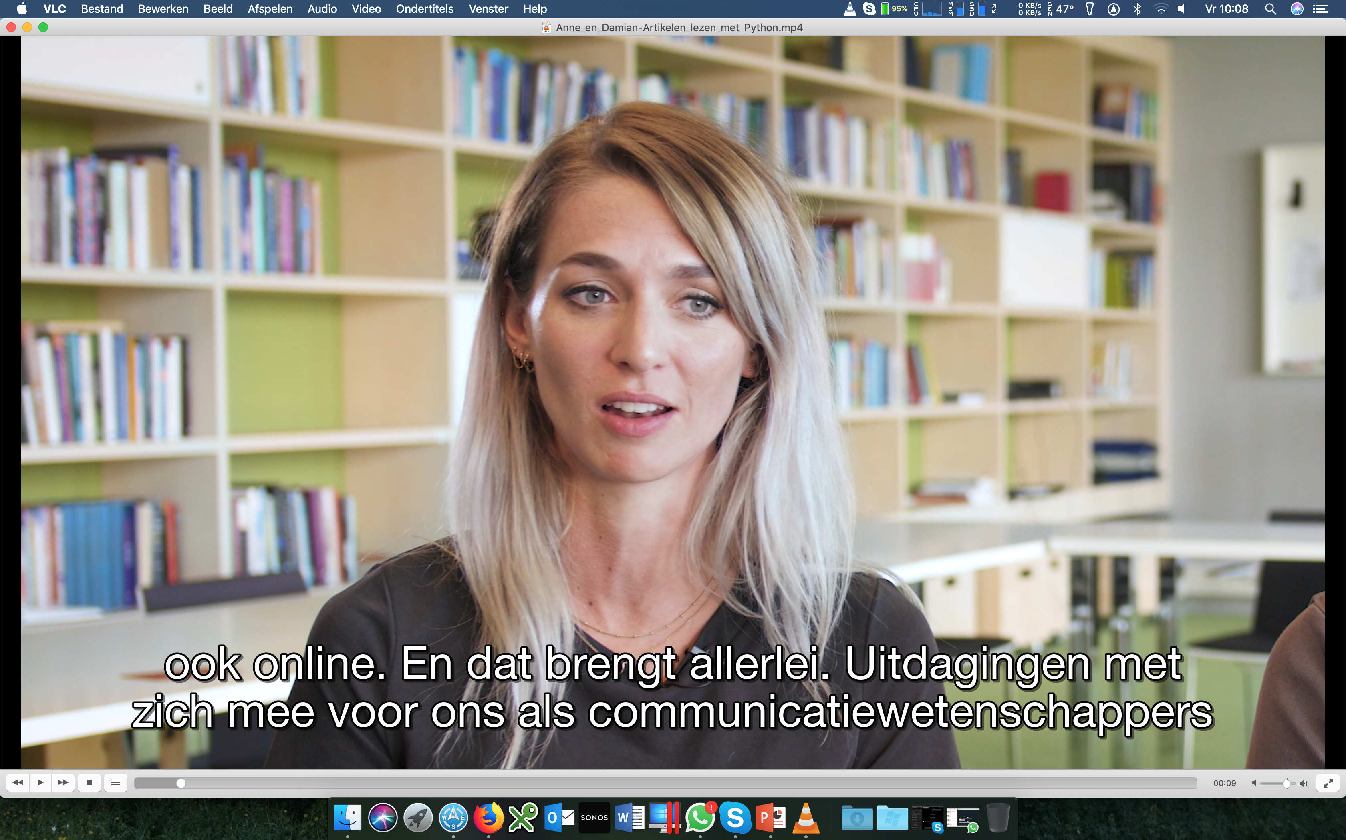
150K hour video
(NL & En)

Slide 60
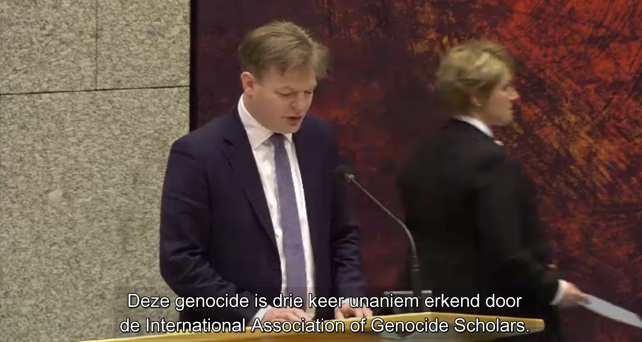
Automatic Subtitling of the Dutch Parliament
Human made close transcription of the speech of the politicians
AV-recording of the meetings
Forced Alignment
Subtitle generation

Slide 62
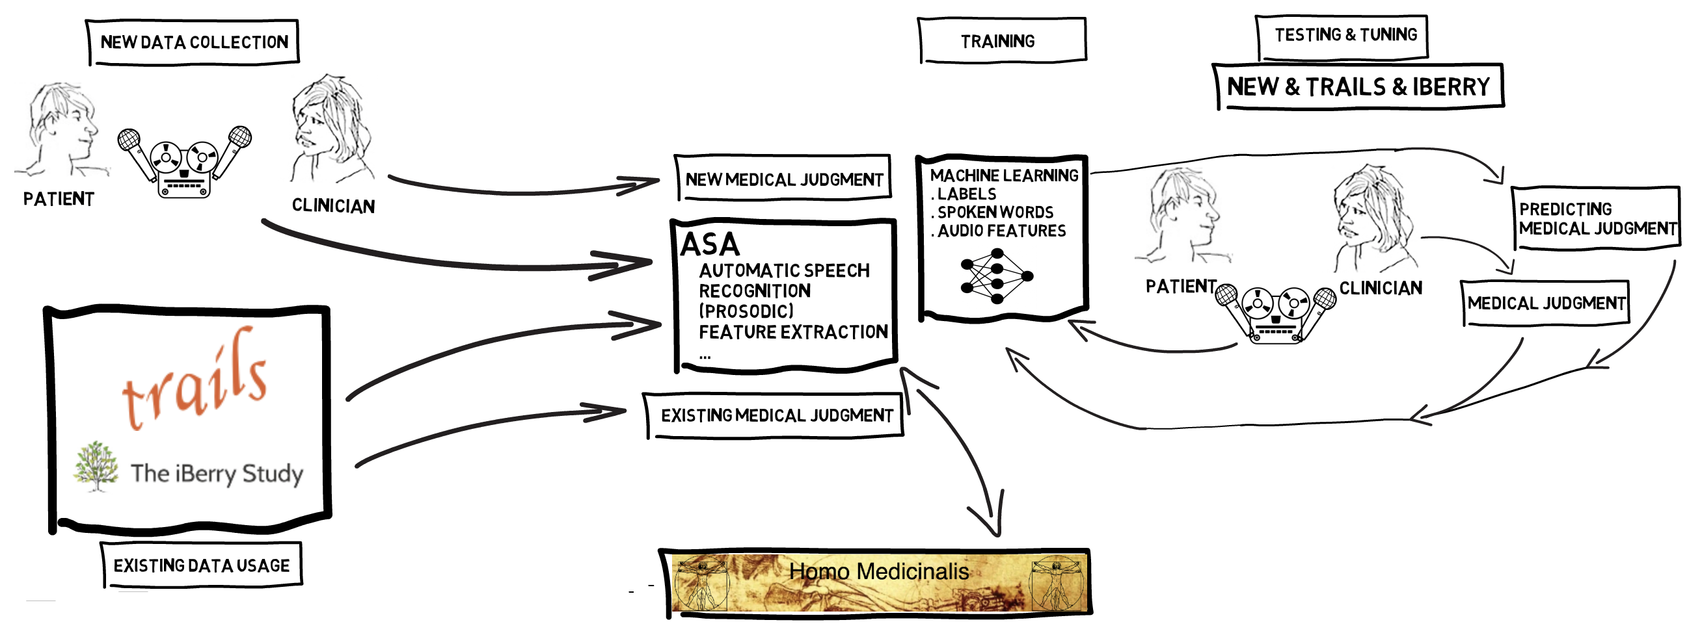
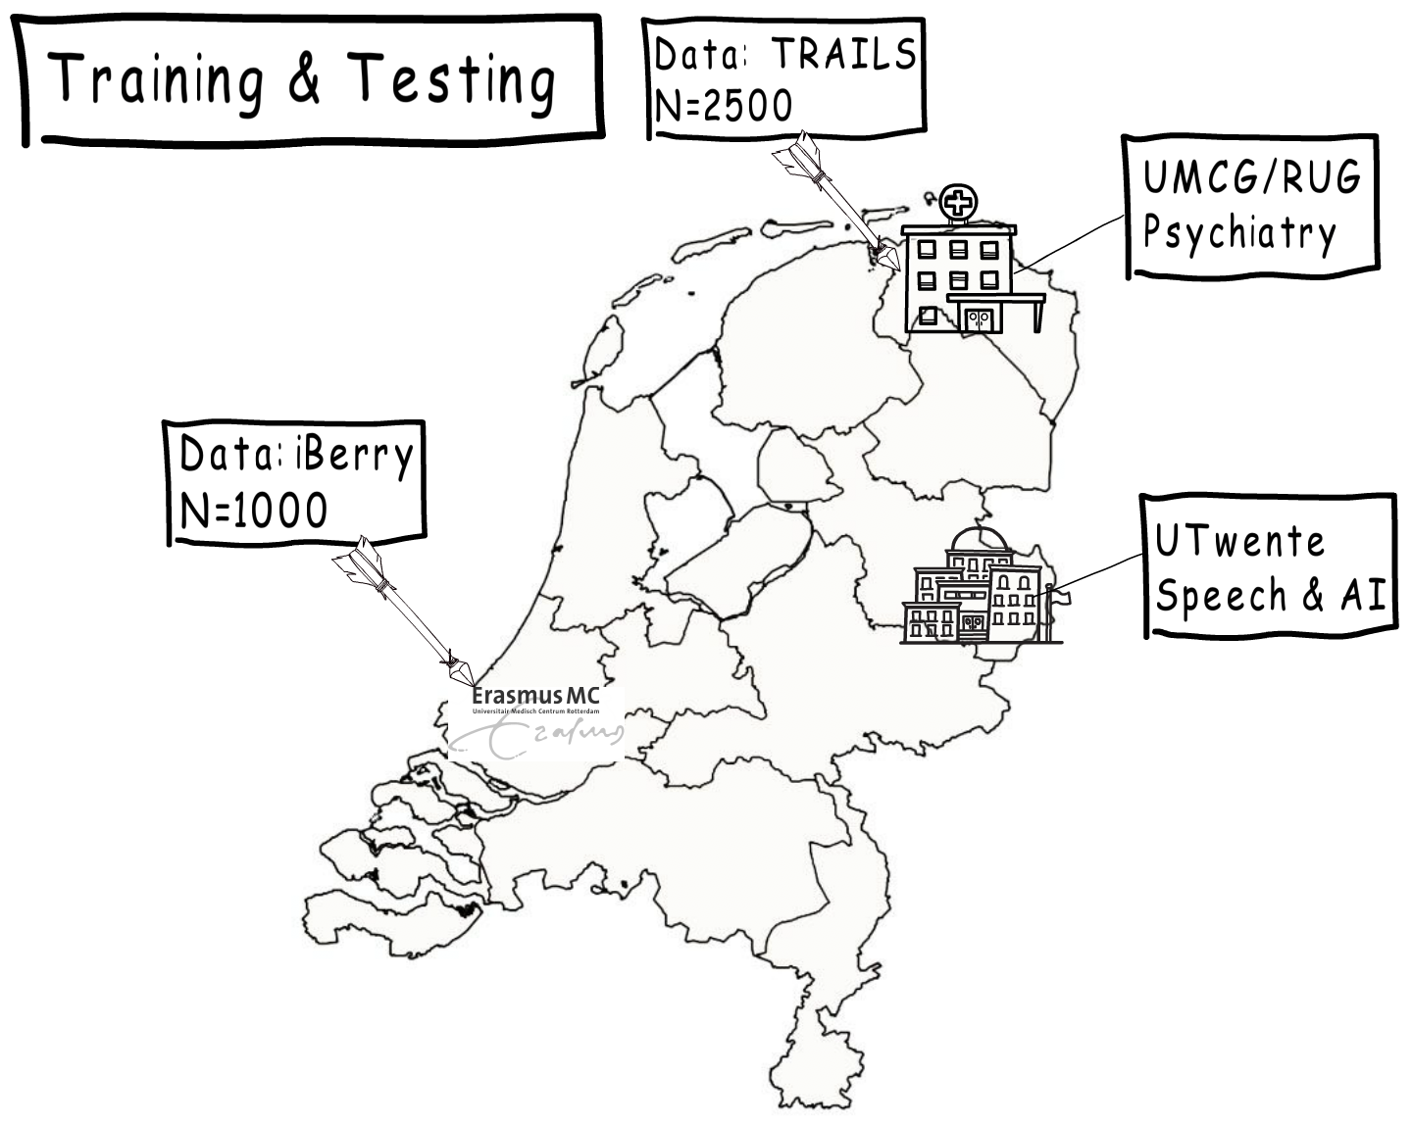
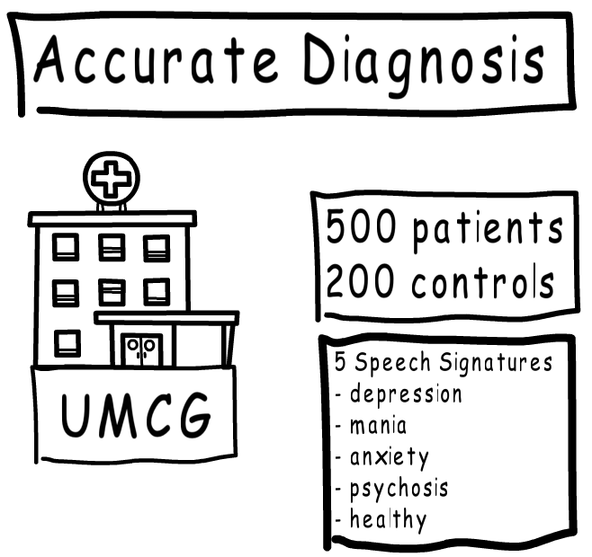
LIPS: detection of brain disorders

Slide 63
Downloadable Software & Links
General info:
https://speechandtech.eu/
Whisper Corrector:
https://speechandtech.eu/tech-tools/software-developed-by-our-team#whispercorrector-how-can-i-correct-the-mistakes-within-an-automatically-generated-transcript-with-the-openai-whisper-engine
Transcription portal:
https://clarin.phonetik.uni-muenchen.de/apps/TranscriptionPortal/

Slide 64
Questions
Mail me at: a.j.vanhessen@utwente.nl

Slide 65
What questions do you have for me?

