Slide 1
A multidisciplinary approach to the use of technology in research: the case of interview data
Louise Corti
and colleagues
Parthenos workshop for CEE Countries 7-9 October 2019,
Sofia

Slide 2
The challenge - crossing disciplines
Working with interview data as a primary or secondary data source
Vast mounts of interview data waiting to be analysed….
New and often unexpected ways of confronting the raw data..’new questions of old data’
But when it comes to techniques and tools, researchers are siloed..choosing the familiar over novel
Observance of Tradition

Slide 3
Different scholarly approaches
Distinct traditions and differences in analytic practices and use of tools by scholars
Automated Speech Recognition
transcription
annotation
text analysis
emotion recognition tools
Potential for digital humanities scholars, historians and social scientists to use speech technology, descriptive and analytical tools for language & linguistic analysis of interview data

Slide 4
When, where and how?
These approaches can support different phases of the research process, from data preparation to analysis and presentation
But the ‘whole tool set’ will be unfamiliar
And, tools are very disconnected….
which and can thwart the needs of a researcher’s analytic journey
and hinder new explorations!

Slide 5
Landscape
What do social scientists do with interviews?

Slide 6
Dimensions of an interview
Focus | Research question topics
The Interview | Identity (e.g. race, ethnicity, gender, age, etc.), experience and ”truth”
Recording of the interview | Power, performance
Transcription of the interview | Narratives, memory
Interpretation of the interview | Subjectivity and intersubjectivity; emotion; cultural representation
Abrams (2010)

Slide 7
Some social science approaches to interview analysis
 | Research questions | Approach
Content analysis | What is the amount and nature of attention/reporting on a subject in a specific media? | Largely quantitative
Conversation analysis | How is social order accomplished in and through interaction in everyday life? | Ethnography and conversation analysis
Discourse analysis | What is the discourse doing? Why some meanings become priviledge or taken for granted and others become marginalized? | Study of well-established meanings/ideas around a topic which shape how we talk about it
Adapted from Bryman (2016)

Slide 8
 | Research questions | Approach
Narrative analysis | How do people make sense of what happened and to what effect? | Interpretation not dependent on veracity of the account • narrative thematic analysis - focus on content and sequence - what is said/not said • structural analysis - focus on language and linguistic practices - how is the story told • Interactional context - focus of co-construction of narratives - why, when, to whom, in what context
Thematic analysis | What are recurrent ideas and topics in the data? | Look at patterns across interviews. Veracity of the account important. Can be combined with narrative analysis

Slide 9
Annotation
Texts, images, audio, video - approaches to annotation differ across disciplines
Linguistics
Behavioral sciences, communication studies
Media studies (film, performance, dance, television)
Social sciences
Digital humanities
Different tools allow for these perspectives

Slide 10
Landscape
What do oral historians do with interviews?
Slides by Norah Karrouche and Max Broekhuizen

Slide 11
Oral history as interviewing practice
Oral history methods mostly deal with oral history as a practice and as an approach to history (minority groups, voice)
Focus on data gathering and publishing the oral histories
Weak tradition of reflecting on analytical frames

Slide 12
Key questions Oral History
What can this person tell me about the past that I cannot find in the archive? (narrative is treated as a factual source)
After the linguistic turn (mid 1980s)
Narrative is treated as an interpretation of a memorized personal past
How does this person perceive theirself looking back on the past?
How do they attribute meaning to their experiences in the past?

Slide 13
Oral history as testimony and as identity
Stories of events, people (and places)
Interviews complement archival sources
Life stories
Interviews gathered in a particular style
Historians (oral historians, biographic approaches, ethnographic approaches)
Construction of identity, intersubjectivity
Testimonies
Historians (oral history, social history, cultural history)
Mediation of memory of events

Slide 14
Ideal-typical analytical approaches
Holistic
One or more interviews
Interpretation of a completed sequence of events or a whole life story
Life story of an immigrant
Categorical
Parts of one or more interviews
Identifying and interpreting specific parts of one or more interview
Leaving home in life story of an immigrant
In practice, we use combinations of these approaches (‘bricolage’)
Thematic
(Parts of) one or more interviews
Content: what is being said?
The experience of leaving home
Structural
(Parts of) one or more interviews
Form: how is it being said?
The way in which the experience of leaving home is narrated (e.g. traumatic, heroic etc.)
Notes:
Approaches tend to overlap

Slide 15
What do oral historians do with interviews?
audio (visual) source
interview prep
interview
summary
contextualizing
transcribing
interpreting
textual source
Synthesis, writing

Slide 16
Landscape
What computational linguists do with spoken corpora?
Slides by Jeannine Beeken

Slide 17
What computational linguists do with spoken corpora?
Formulating
research questions
hypotheses to be confirmed/disconfirmed
Exploring
and selecting data on certain criteria (representativity, language, availability, format, quality, etc.)
Testing, selecting and evaluating tools for analysis
Pre-processing (when needed)
data transformation (e.g. speech to text, transcription), cleaning (e.g. errors correction), conversion (one format to another)
data enrichment (identification of speakers, roles, characteristics - age, gender, language -, uncertain and missing elements, etc.)
data structuring/grouping (chronology, language, typology of spoken data, etc.)

Slide 18
What computational linguists do with spoken corpora?
Analysing
applying methods/tools for part of speech tagging, lemmatization, frequency counts, comparing, clustering, parsing, disambiguation, computing semantic similarities, recognition of named entities, sentiment analysis, etc.
Interpreting
analysis results taking also into account the context (geo-historical, social, political, linguistic, methodological - in collecting and processing the data, etc.)
Evaluating
added value, limitations, biais, possibility of generalisation, range of errors, formulating further questions/hypotheses to be studied, etc.

Slide 19
Verbal vs. non-verbal
Verbal: spoken (sounds, speech) vs. written (text, silent)
Non-verbal: signs, body language and symbols (silent)
Excerpt from a silent film https://www.youtube.com/watch?v=4QrR_1NW_w4 (1.10min)

Slide 20
Verbal communication: oral vs. written
Speech vs. silence
Spelling: punctuation marks, capital letters, apostrophe, brackets
Your first/family name with/without capital
Paris Jackson, Orlando Bloom, mother(-)of(-)P/pearl
Homophones: seas, sees, seize; friar, fryer; nun, none; grease, Greece
Silent letters (speech): knead, kneed (need); knows (noes, nose)
Homographs: minute, lead, object, tear
Homophone + homograph: arms, ball, spring, duck, watch, ring

Slide 21
Key challenges for linguistic tools
Separate/Disambiguate
Tokenizers (characters, words etc)
sentence splitters
Part of Speech (POS) taggers (nouns, verbs etc.)
Parsers (grammatical structure)
Named Entity Recognition (NER)
Word Sense Disambiguation (WSD)

Slide 22
Key challenges for linguistic tools
Cluster/Group
Spell checkers
Lemmatizers (walk, walks, walking, walked)
Synonyms
Multiword Expressions (MWE)
collocations, idioms, coreferencing

Slide 23
Key challenges for linguistic tools
Control/Reduce
Stopwords; whitelists and blacklist
Keyword extraction (with, without a CV)
Summarizers

Slide 24
Landscape
What do sociolinguists do with spoken corpora?
Slides by Silvia Calamai
Sociolinguists meets
qualitative research?

Slide 25
Morphology
Syntax
Phonetics
Phonology
structure
structure
Semantics
structure
structure
Corpus Linguistics
LINGUISTICS
DATA = speech either in text or in sound
Neuro linguistics
use
structure
Ethno
Linguistics
Socio
linguistics
Discourse/
Conversation analysis
Pragmatics
use
use
use
use

Slide 26
Key questions Sociolinguists
WHO IS SPEAKING ?
How long? How do they take turns?
concepts: overlap/interruption; dialogic repetition; free indirect discourse; polyphonic monologues… )
What are the topics of the interview, semantics, frequency of words
What are the styles? What does style tell us about the speakers?
Why do the speakers speak the way they speak?
Why do they change style and when?
(concepts: accommodation, entrainment, linguistic repertoire)
WHAT AND HOW?

Slide 27
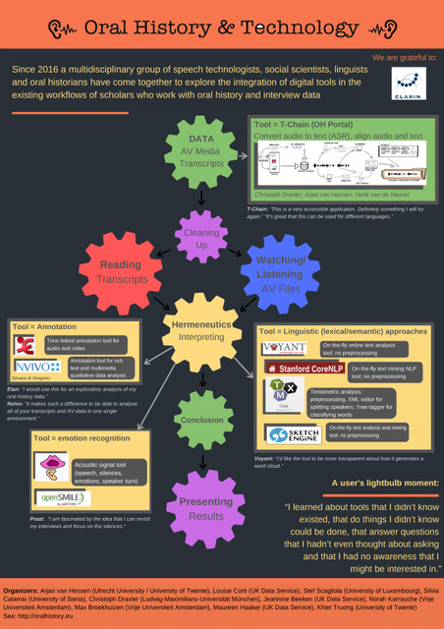
TOOLS for the jobs
Discover
Prepare
Analyse
Report

Slide 28
Discovery: In depth interview data
Hard to find publicly available FAIR data sources
That are Findable /discoverable
Often inAccessible: GDPR, consent, copyright
Rarely are they Interoperable: formats/metadata
Reusable? Some have good provenance information

Slide 29
Available qualitative collections
CESSDA archives: https://www.cessda.eu/
From academic research studies
Arising from donations or Research Data Policy
UK Data Service - self deposit / curated collections
DANS - self deposit / curated collections
Others
From local cultural enterprise
Museums and libraries (National Life Story Collection)
Local records offices

Slide 30
How NVivo supports analysis
Thanks to Silvana di Gregorio for slide input

Slide 31
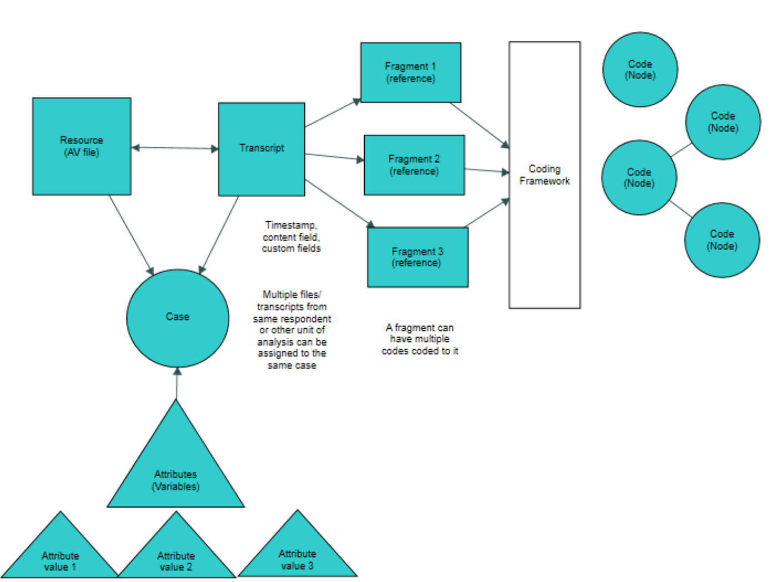
NVivo Structure

Slide 32
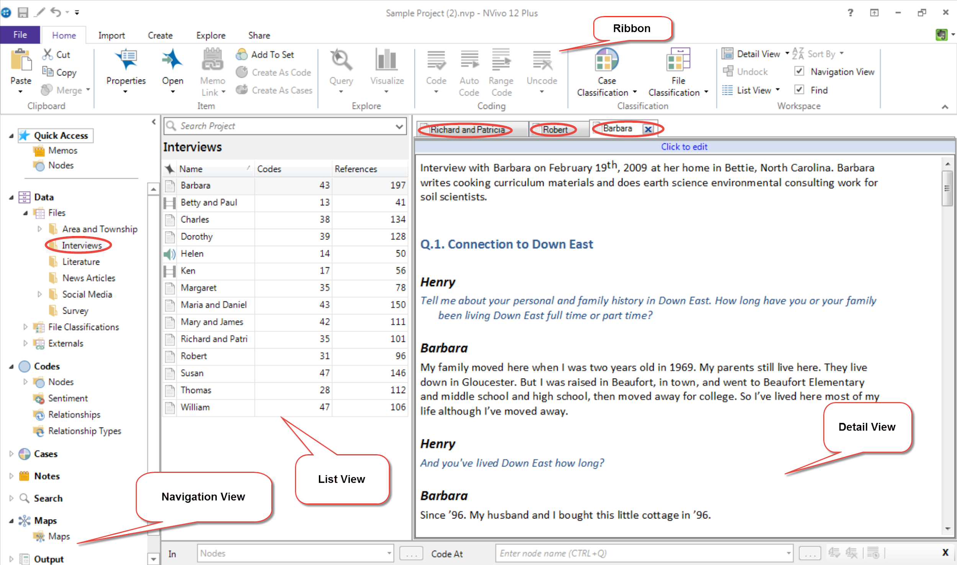
The NVivo Workspace - Windows

Slide 33
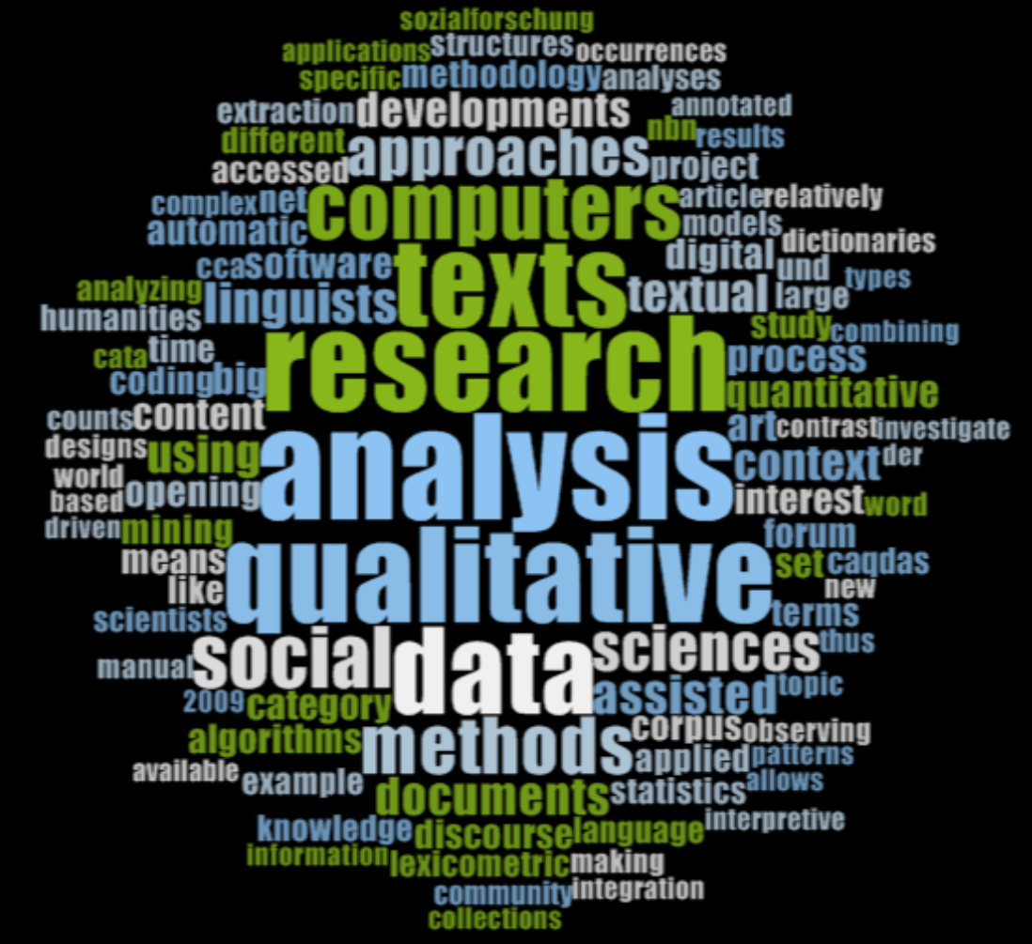
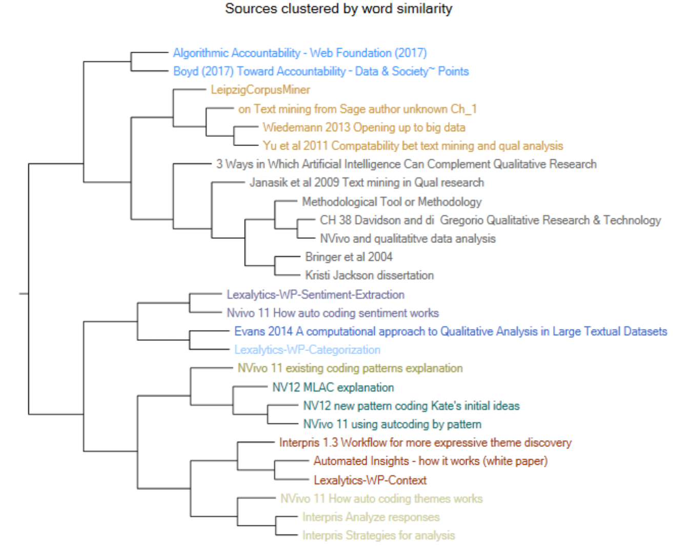
NVivo Analysis Tools
Translation of social science manual methods
Basic corpus linguistic tools
Coding with stripes (within datum)
Code retrieval (across data)
Catalogue system
Text search
Query coding
Word frequency
Word tree - KWIC
Clustering by words or coding
Cases
Variables
Artificial Intelligence tools
Machine Learning autocoding
Models/ maps
Comparison diagram
Sociogram
Explore diagram
Autocoding by theme
Autocoding by sentiment

Slide 34
ELAN (EUDICO Linguistic Annotator)
Open source desktop tool for manual (computer-assisted) annotation (and semi-automatic enrichment) of multimedia
Developed at the Max Planck Institute for Psycholinguistics, Nijmegen (The Netherlands)
Multi-tier, multi-speaker, time-linked annotation of audio and video recordings
Produces xml files (.eaf)
Thanks to Lilian Melgar for slide input
Notes:
ELAN (EUDICO Linguistic Annotator) is an annotation tool that allows you to create, edit, visualize and search annotations for video and audio data. It was developed at the Max Planck Institute for Psycholinguistics, Nijmegen, The Netherlands, with the aim to provide a sound technological basis for the annotation and exploitation of multi-media recordings.

Slide 35
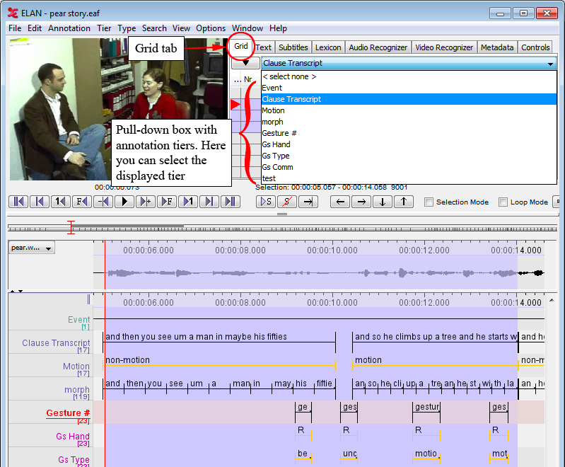
Use of Tiers
“A tier is a set of annotations that share the same characteristics”
Tiers are “facets” (same type of annotation, or “event”)
They represent different analytical aspects
Tiers contain annotations
They can be grouped hierarchically
Notes:
In this other example you see

Slide 36
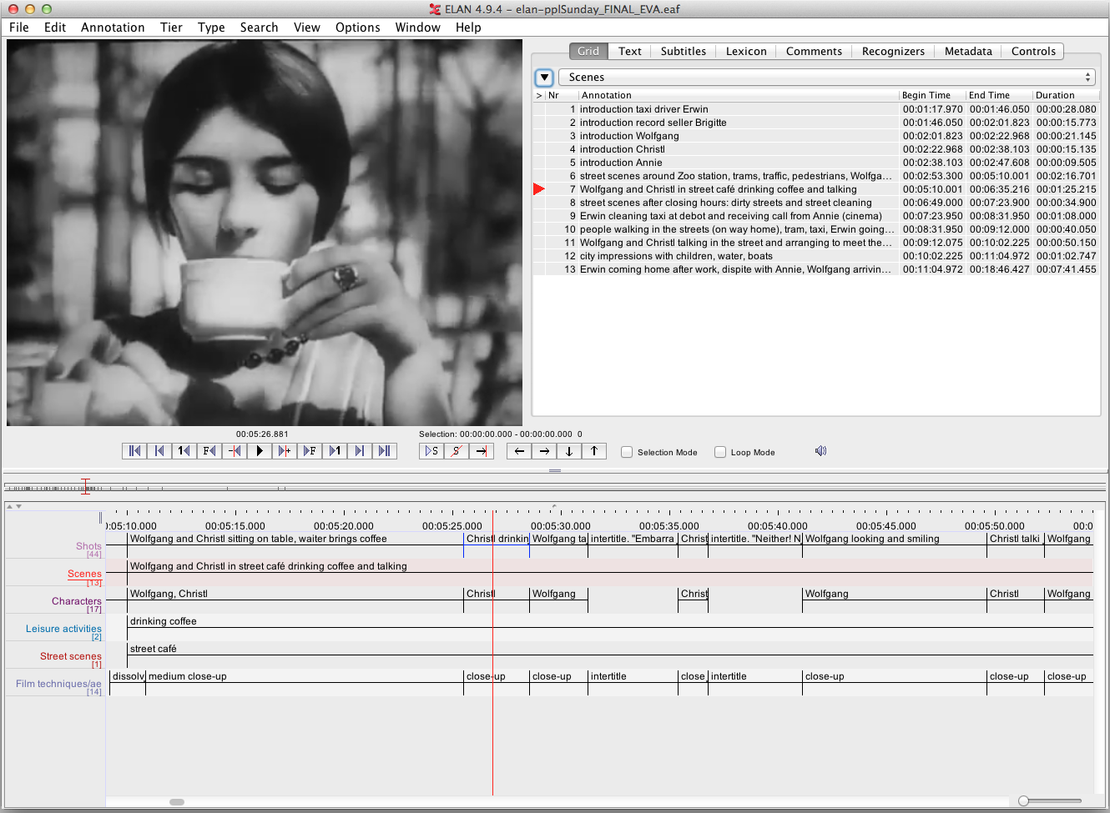
Tiered approach - 1
More details in: Sloetjes (2012); Melgar et al., 2017
Notes:
For example, film studies.
A tier is…
In this screenshot you see the analysis of a film using ELAN. The tiers are...

Slide 37
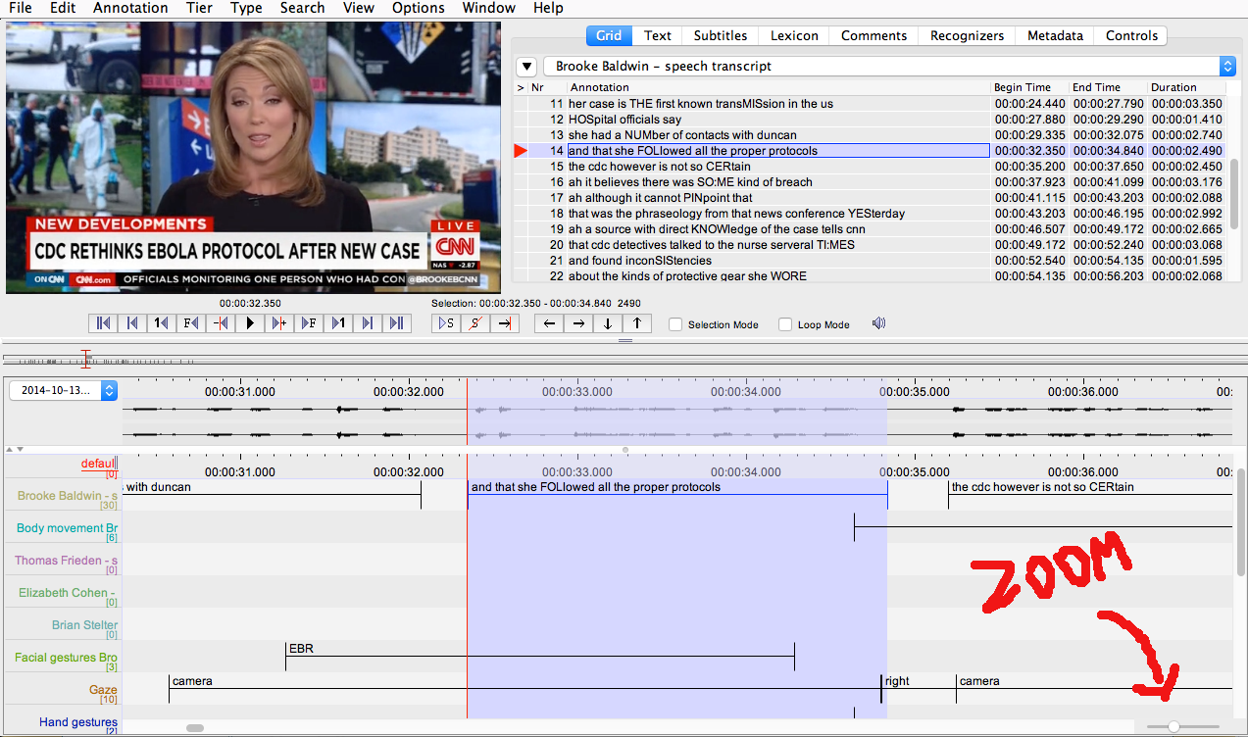
Tiered approach - 2
Notes:
In this other example you see

Slide 38
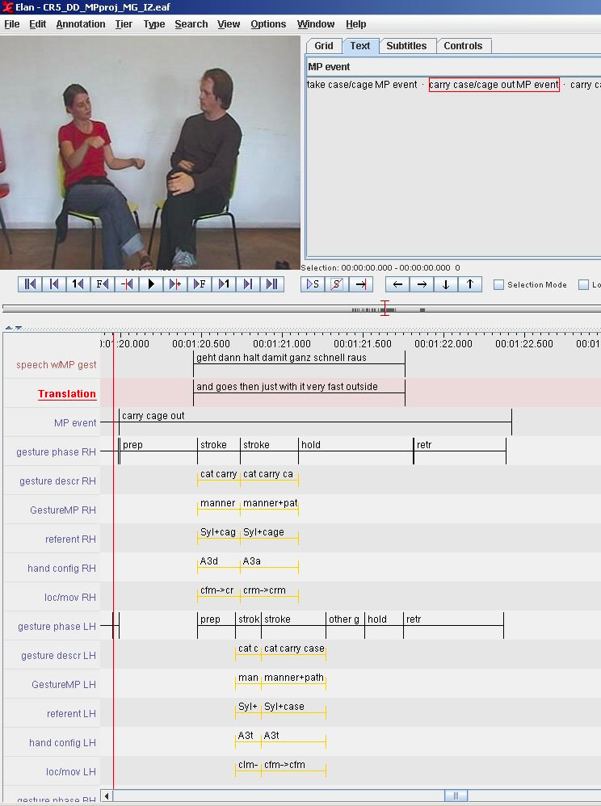
Tiered approach - 3
Notes:
Gesture analysis

Slide 39
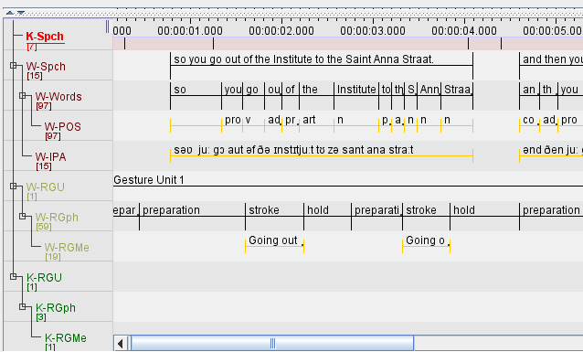
Tiered approach - 4
Notes:
In this other example you see

Slide 40
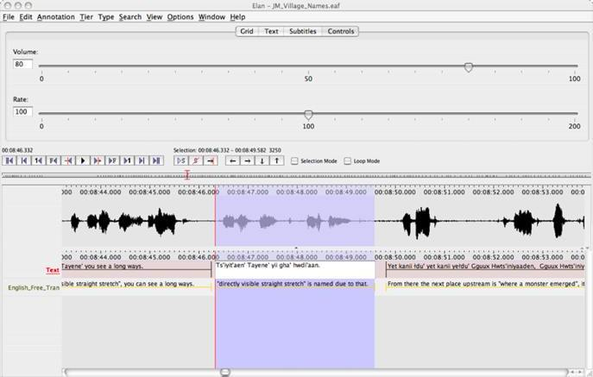
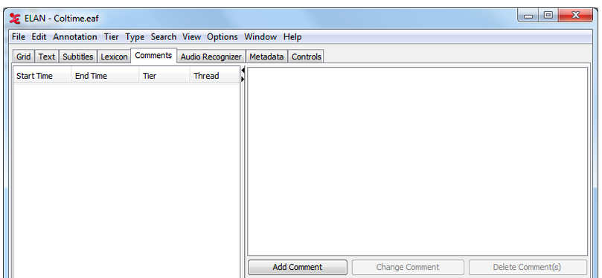
Annotating in ELAN - master the controls
ELAN understands “annotation” as the content of the segments (e.g., transcripts, codes, etc.):
segments are containers for annotations
Each annotation is entered on a tier and assigned to a time interval
There is also the possibility to add comments

Slide 41
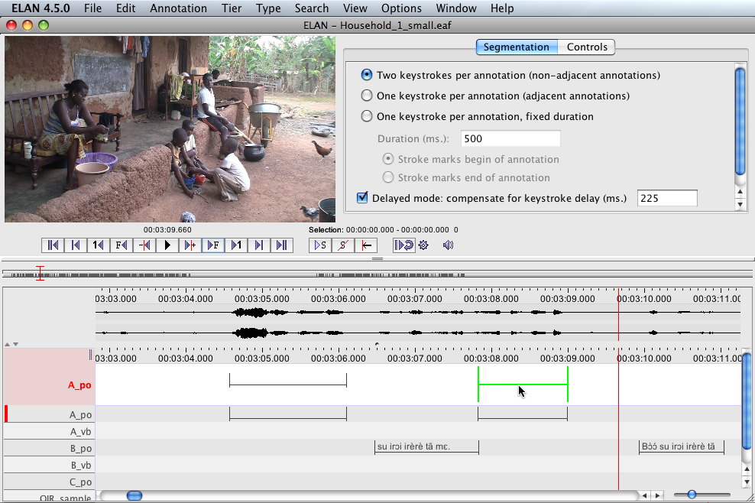
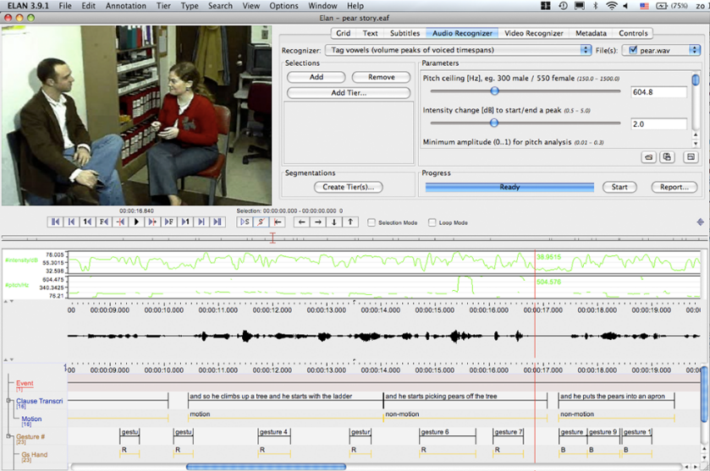
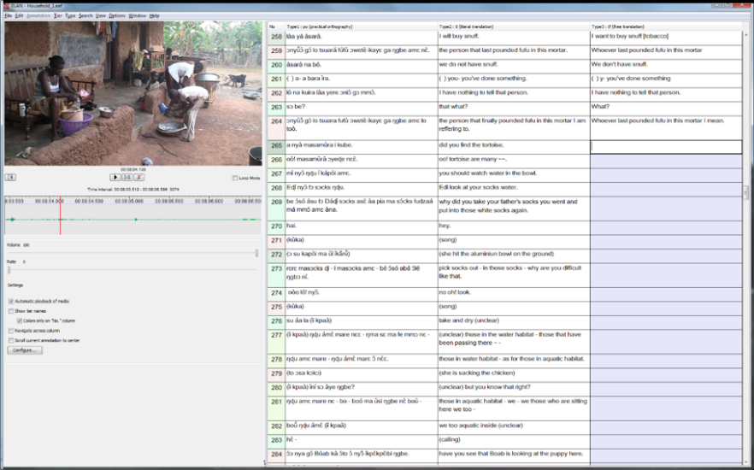
ELAN’s working modes
Segmentation mode
Annotation mode
Synchronization mode
Transcription mode

Slide 42
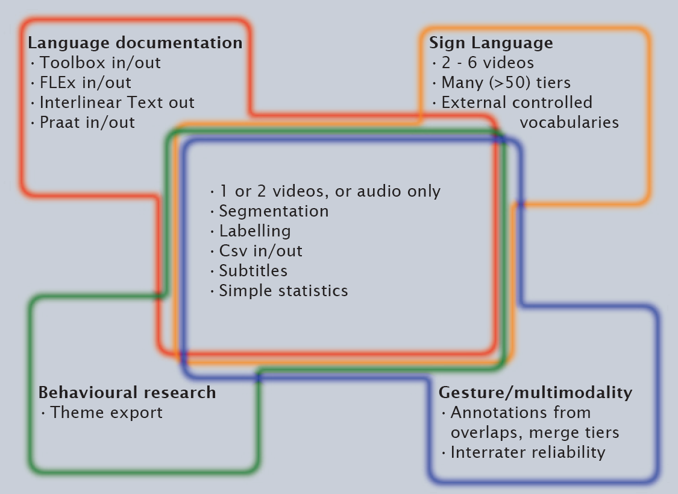
ELAN user communities
Language documentation
Sign Language research
Gesture research
Multimodality research
Behavioural studies
Psychology, psychiatry
Other...
Original slide by Han Sloetjes
Notes:
ELAN is specifically designed for the analysis of languages, sign languages, and gestures, but it can also be used by anyone who works with media corpora, i.e., with video and/or audio data, for purposes of annotation, analysis and documentation.
Its tiered approach makes it appealing to other disciplines

Slide 43
Linguistic Analysis - Free Tool
SketchEngine at https://auth.sketchengine.eu/#login
User Manual at
https://www.sketchengine.eu/user-guide/user-manual/

Slide 44
Landscape
What affective social sign processing scholars do with spoken data

Slide 45
Social Signal Processing
“How can emotions be generated in computers, recognized by computers, and expressed by computers?”
“SSP is the computing domain aimed at the modeling, analysis, and synthesis of social signals in human-human and human-machine interactions.”
“How can we automatically analyse and interpret human behavior in human-human and human-machine interactions?”

Slide 46
Social Signal Processing in Oral History
Khiet Truong’s Video:
https://drive.google.com/file/d/1-ooofaXzR3RWe9fL75NBQGT34B0KdbH2/view
Location:
https://drive.google.com/drive/folders/150Qe3itZArR0s2sAArPcaFUJT2YI9Y_9

Slide 47
Appreciating differences
Scholars often ingrained in their ways
But can see potential in alternative methods
Can provide additional new angles e.g. for social scientists to explore the role of audio/speech/emotion in a guided conversation
Social science/oral historians - better question the role of an acquired textual ‘transcription’

Slide 48
Challenge no 1: the jargon
Jargon - techniques and tools
Getting to know a ‘new paradigm’
Time is needed to work through analytical approaches and their own dedicated terminology
So many acronyms, unfamiliar terms!
Annotation types: annotation, coding, nodes
Different and competing metadata schemas
Suggest lay descriptions of tools and key functionality

Slide 49
Challenge no 2: accessing the technology
Technology - installation and (lack) of documentation
Time and sometimes expertise may be needed to install open-source software, register, and get it working
Technical barriers e.g. the platform and OS - linux, mac, windows only
Many researchers struggle to download software, suggesting a lack of basic technical proficiency
And the problem of Admin access!

Slide 50
Challenge no 3: using the tool
The tool - working the tool
Time is needed to work through a new tool/ become familiar with it
Preprocessing of data may be needed
Watching an orientation video in advance helps
Step-by-step guides and familiar teaching data and work through exercises very useful
Be brave and curious
Ask for advice and/or training
Work collaboratively across discplines

Slide 51
Challenge no 4: finding and accessing data
The data - much interview data not open or discoverable
Hard to find suitable accessible collections for the user
Limited ‘metadata’, often manually created, overview. Free text and index terms often describe the research/data collection method, not content
Data publishers could use language tools to better emerge content e.g. auto-summarisation and concept extraction

Slide 52
Thank you! corti@essex.ac.uk @LouiseCorti ukdataservice.ac.uk oralhistory.eu

